Slide 1

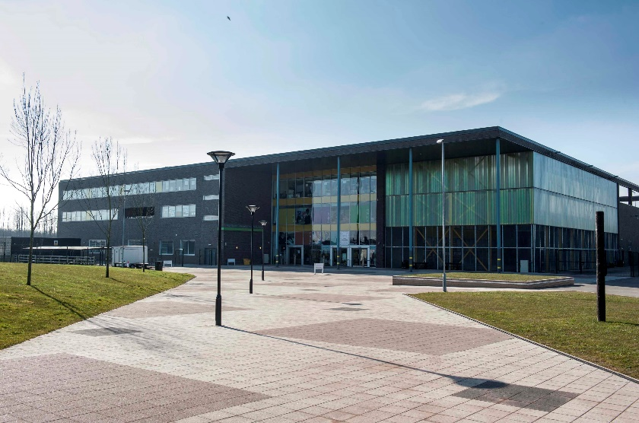


Year 6 Transition Evening
Thursday 19th June 2025
Maximising our Potential

Slide 2
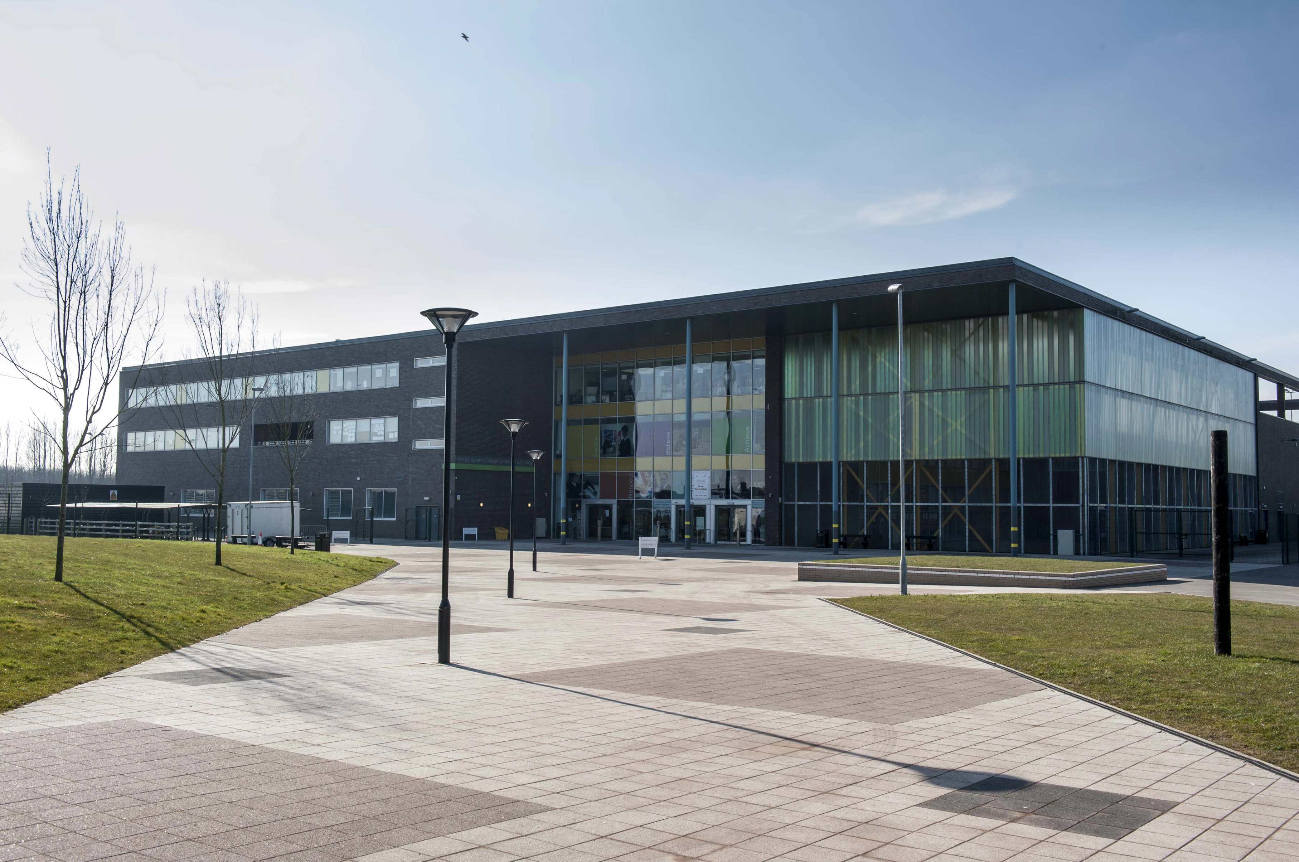

Headteacher
Mrs Dobson
Maximising our Potential

Slide 3


Kirkby High School

Slide 4
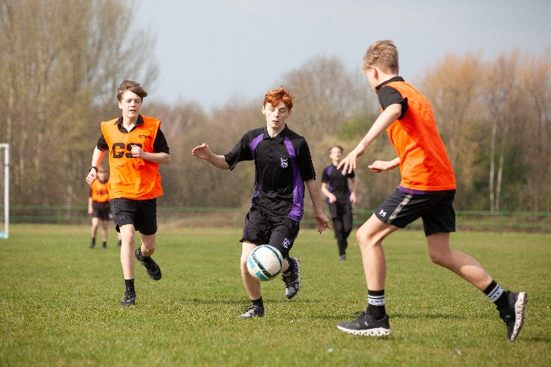

Our Philosophy
Maximising our Potential

Slide 5
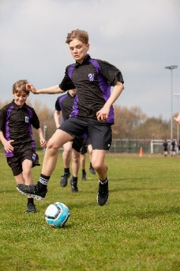
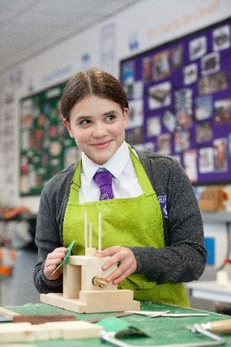

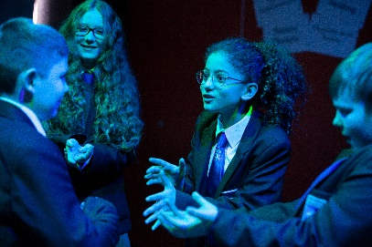
Our Vision
A community driven by high expectations
and mutual respect providing all
individuals with the belief and opportunities
to succeed now and in the future

Slide 6


Slide 7
The Kirkby Code
Our Curriculum for Behaviour
Allow teachers to teach, and students to learn
Do things first time, every time
Be prepared to learn, with the correct equipment
Be respectful to others and our environment
Do all things to the best of my ability

Slide 8
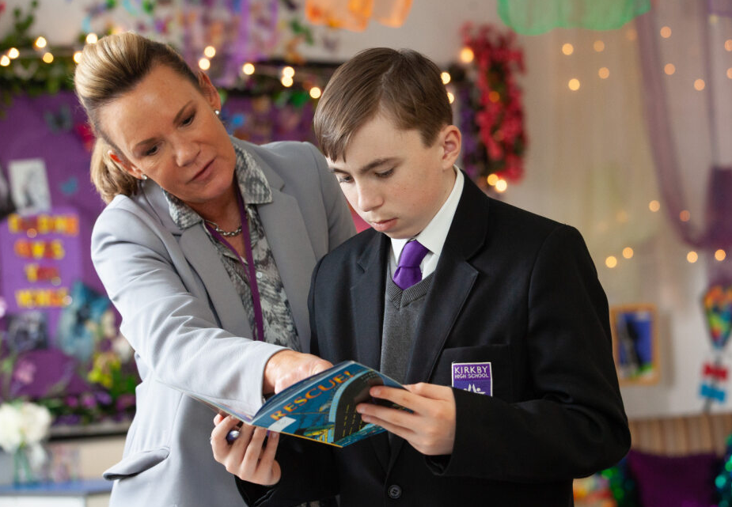
Mrs Butler
Assistant Headteacher Transition and Year 7 Link
Maximising Our Potential

Slide 9

Attendance

Slide 10

0% to 4% then you are…
Attendance
If your absence is
HIGHLY LIKELY TO ACHIEVE WELL
5% to 10% then you are…
QUITE LIKELY TO ACHIEVE WELL
10% or more then you are…
NOT VERY LIKELY TO ACHIEVE WELL

Slide 11
Attendance
Persistently absent means that a child misses10% or more of days in school.
Why it matters
Year 11 pupils with near-perfect attendance are almost twice as likely to achieve grade 5 in English and Maths GCSE, compared to similar pupils who are persistently absent
Students who are persistently absent are 60% less likely to be employed compared to those with below 5% absence when they are older
Habits need to start in Year 7

Slide 12

Attendance
4% absence is the expectation
HIGHLY LIKELY TO ACHIEVE WELL

Slide 13
Attendance
What to do if your child is absent?
Please call the school office and leave a message on your child’s first day of absence
Our attendance mentors will be in contact and visit your home if the absence continues and no reason is provided
Aim to have medical appointments outside of school hours where possible
Term time holidays are not approved
Year 7 children may worry about school and may say that they are ill. If you suspect this, please call me and their worries are easily dealt with

Slide 14
Punctuality
Lost minutes mean lost learning. Did you know that being late 15 minutes every day is the same as missing 2 whole weeks of school over a full academic year?
Don’t be late…be here by 8:38

Slide 15
Career and Aspirations
Careers education and guidance in every year
Opportunities to visit local colleges and universities
Work experience in Year 10
Promote aspiration at every opportunity

Slide 16
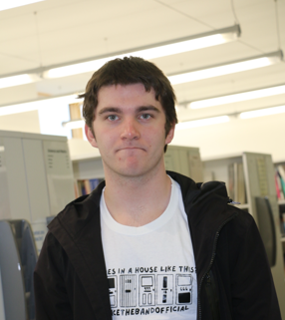
Post 16 Destinations
Alex Rogers
Secured an offer to study Philosophy at Cambridge University in September 2025

Slide 17
Teaching and Learning
Do Now activities
Recall and retrieval
Modelling
Deliberate Practice
Homework
Assessments
Feedback
Maximising Our Potential

Slide 18

Communication
Please download the app to use on your phone
Provide a valid email address to the school to access your account
Full details will be provided in September
Maximising Our Potential

Slide 19
Homework Expectations
Homework is set regularly, and it is expected students complete it and hand it in on time.
Homework may be completed in exercise books or worksheets.
All homework is recorded on Arbor, for which your child (and you) will have a log-in.

Slide 20




Safeguarding,wellbeing and support offer at Kirkby High School

Slide 21

Let’s talk about mental health
How it may look
Feeling anxious
Feeling sad
Feeling being bullied
Not sleep properly
Worrying about things
Frightened
Self-harming
Always falling out with friends
Finding lessons difficult
Feeling lonely
Maximising Our Potential

Slide 22
Let’s talk about mental health
How we can support
Parents
Friends
Form Tutor
Head of Year
Pastoral Mentors
Attendance Mentors
Inclusion Team
Rainbow Club
Tackling the Blues
Children’s Society
Zuntold
Maximising Our Potential

Slide 23
Who to contact if you have
an issue?
Year 7 Head of Year: Miss Morrin
Year 7 Pastoral Mentor: Mrs Ellis
Your child’s Form Tutor
Assistant Headteacher/SENDCO: Mr Carroll
Head of Inclusion: Mrs Hughes
Assistant Headteacher/Year 7 Link: Mrs Butler
Mrs Rigby: Designated Safeguarding Lead
transition@kirkbyhighschool.net

Slide 24
Student Leadership
Head Boy – Freddi
Head Girl – Poppy
Maximising Our Potential

Slide 25
Miss Morrin
Head of Year 7
Maximising Our Potential

Slide 26
Uniform
High standards and expectations regarding uniform
Full uniform list and PE kit can be found on our website and in the Year 6 transition booklet
Please ensure names are in or on all items of clothing
School skirts or slips need to be knee length
Blazers must be worn at all times around the school building
Hair brushes are not to be seen around school and will be confiscated
Your uniform order is ready to be picked up this evening. If you require a different size or have not yet ordered, please visit Kids Kirkby after 7th July.

Slide 27




School Bags
Your child’s school bag must big enough to carry an A4 planner and homework folder
Students will also need to carry
Pencil case (including pencils, pens, ruler, sharpener, rubber, colour pencils)
Bottle of water
PE kit/food technology ingredients (on days when these items are needed)

Slide 28
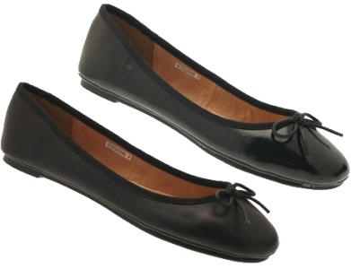
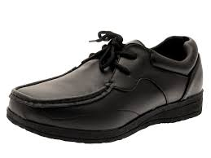
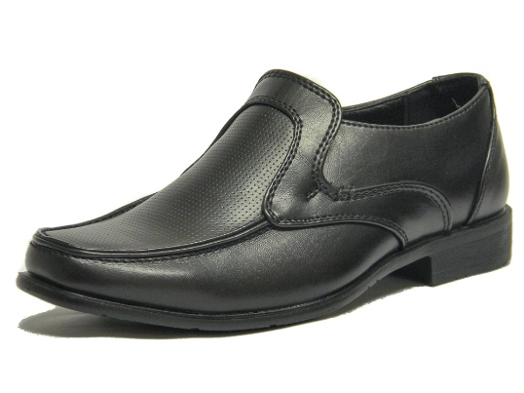
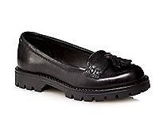
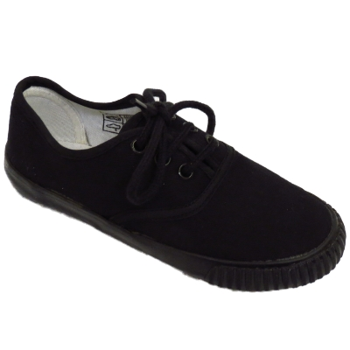
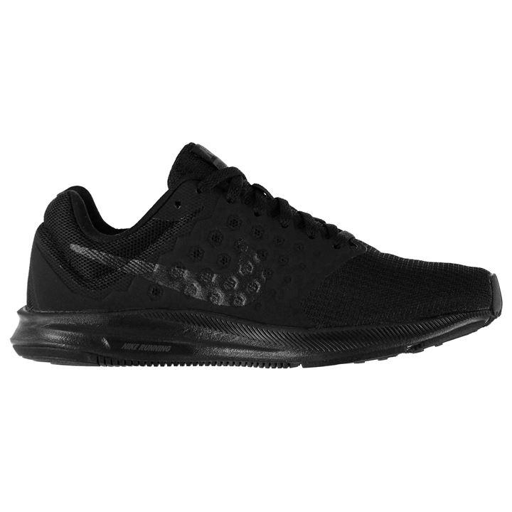
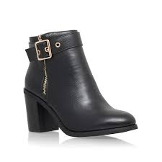
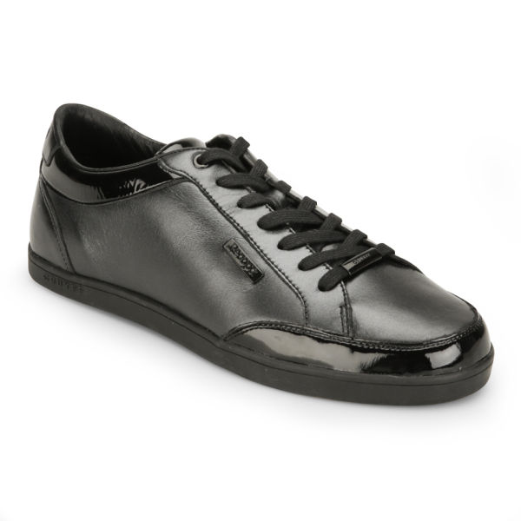

Shoes

Slide 29




Coats
No logos
No hoodies or tracksuit tops

Slide 30
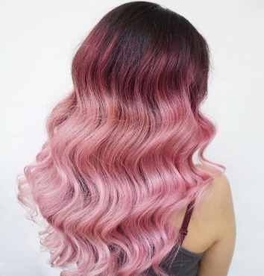
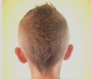
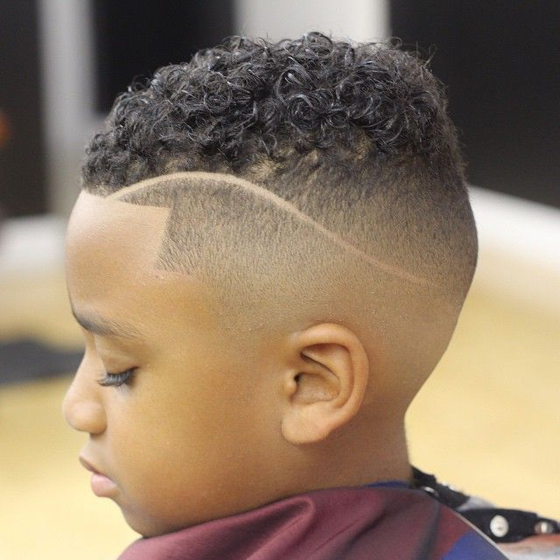
Personal Appearance
Hair not shorter than ‘No.2’
No extreme styles or ‘Mohican’ styles
No lines shaved
No un-natural colours/ obvious streaks

Slide 31
Personal Appearance
No makeup is to be worn for school. Students will be asked to remove any with a face wipe during form time
No painted or false nails
No false eyelashes
Students will receive a sanction if they refuse to remove the above or we have persistent issues.

Slide 32
Banned Items
Jewellery (with the exception of a wrist watch)
Mobile phones/smart watches must be switched off at the school gates and completely out of sight throughout the day
Aerosol/body sprays are completely banned as they can affect the fire alarm system and are problematic to children with asthma
Fizzy drinks and energy drinks are completely banned and will not be returned
Anything confiscated will be placed in the school office for collection by an adult later that day or on following days

Slide 33
School Bus Services
771 - Towerhill/Quarry Green
Morning |  | After School
Bank Lane/Windermere Drive | 07:50 | Kirkby High School | 15:20
Headbolt Lane/County road | 08:00 | Kirkby Station | 15:30
Quarry Green | 08:13 | Headbolt Lane/ County Rd | 15:35
Kirkby Station | 08:18 | Windermere Drive | 15:45
Kirkby High School | 08:30 | Quarry Green | 15:55
Bus fare is £1 per journey

Slide 34
School Bus Services
772 - Northwood
Morning |  | After School
All Saints School | 08:05 | Kirkby High School | 15:20
Bramcote Walk | 08:10 | Simonswood Walk | 15:30
Quarry Green | 08:13 | Quarry Green | 15:32
Simonswood Walk | 08:20 | Bramcote Walk | 15:35
Kirkby High School | 08:30 | All Saints Sch | 15:40
Bus fare is £1 per journey

Slide 35
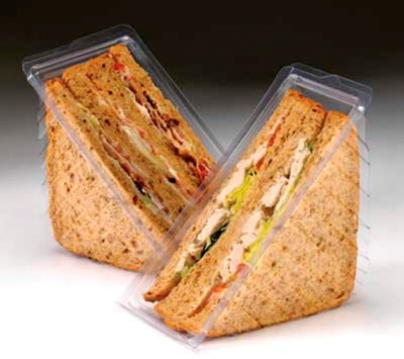
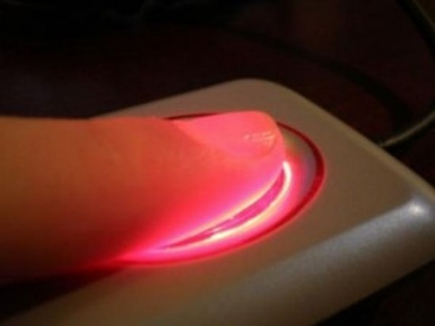
The Canteen
Cashless biometric system on Arbor
Allergies – complete dietary requirements details form ASAP
Those eligible for free school meals will have money added automatically
Maximising Our Potential

Slide 36
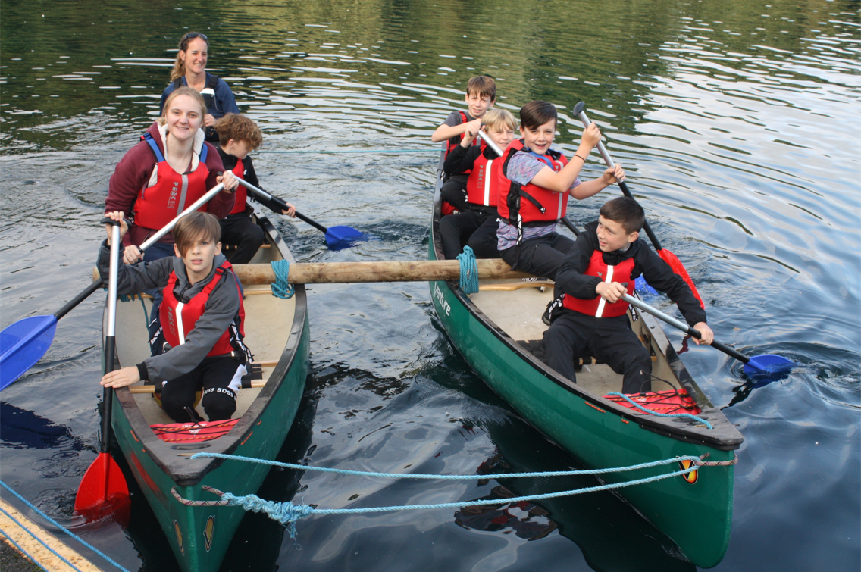
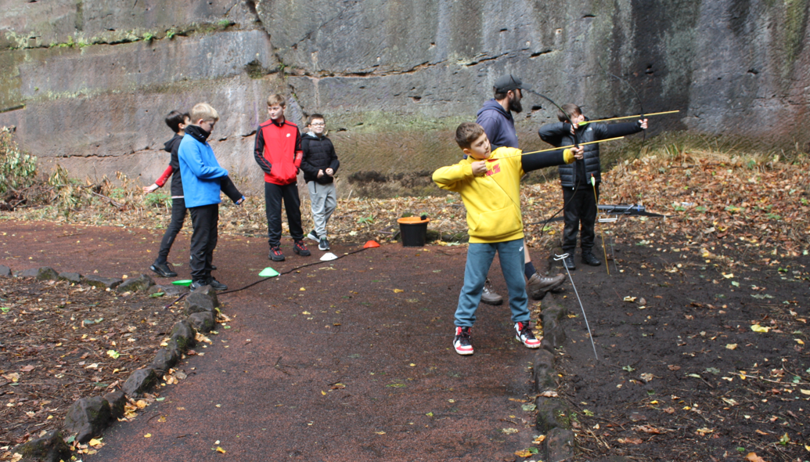
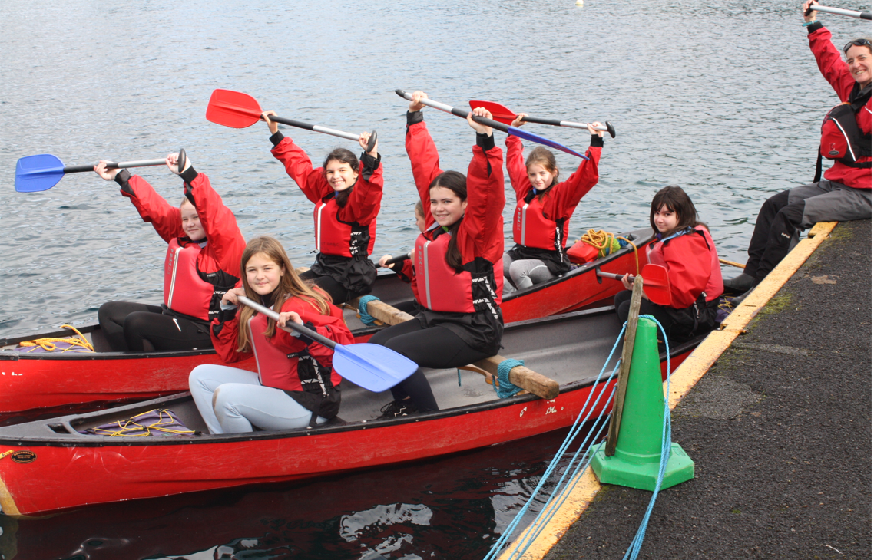
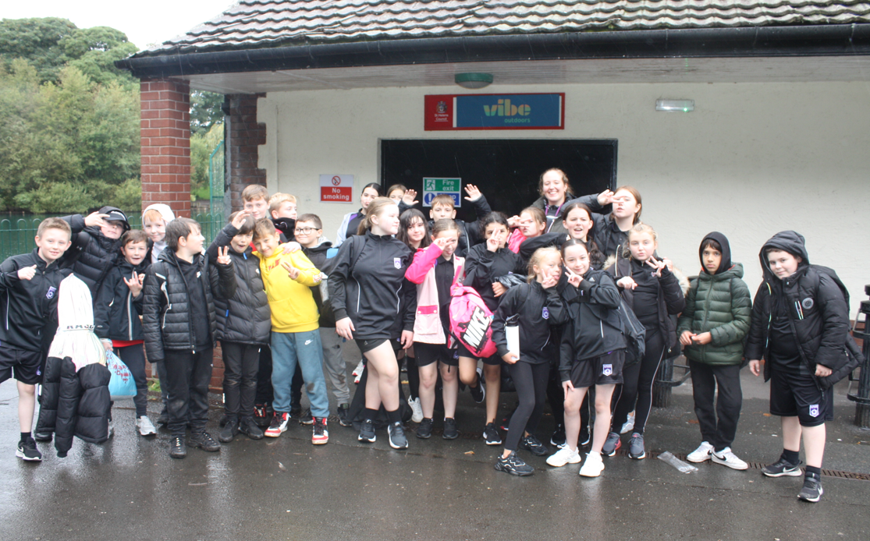
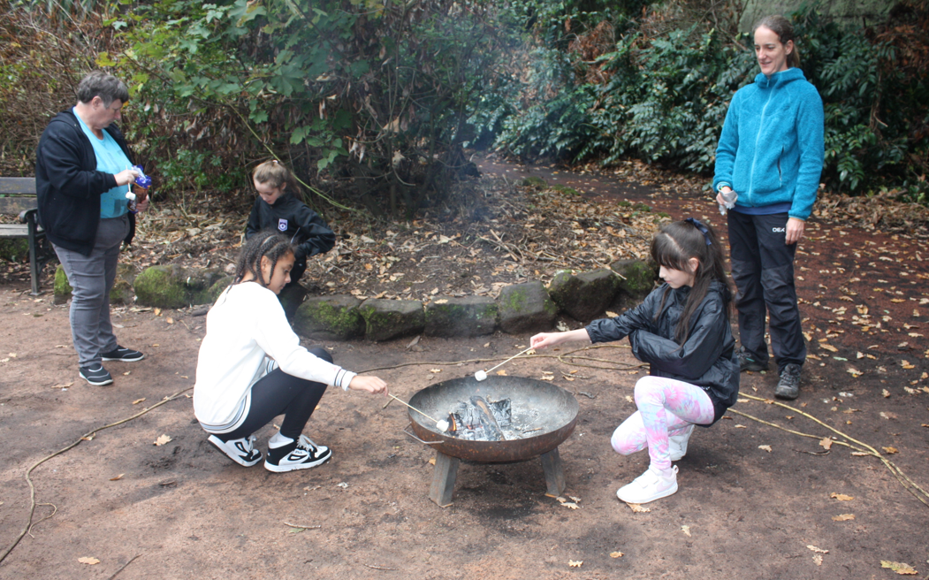
Year 7 Team Building

Slide 37
How can you support
your child
Ensure your child is prepared for school each day
Be extra vigilant with social media
Keep up to date with the Arbor app
Maximising Our Potential

Slide 38
If the member of staff you need to speak to is unavailable…
Unless it is an emergency, please avoid coming to reception and asking to see a specific member of staff as they are likely to be teaching or in a meeting
Please ring or email admin@kirkbyhighschool.net and request an appointment
Please do not email staff directly
Leave a message with the office and someone will get back to you (may sometimes be after 3pm)
An emergency situation will be treated differently
Maximising Our Potential

Slide 39
Year 7 Student
Jamie Saad
Maximising Our Potential

Slide 40
Thank you for choosing Kirkby High School
Any questions or concerns, please email transition@kirkbyhighschool.net
Maximising Our Potential

