Slide 1
Kirkby High School Initial Information Evening
Mrs Dobson
Headteacher
Mrs Butler
Assistant
Headteacher
Thursday 21st
March 2024
5:00pm

Slide 2
Kirkby High School

Slide 3
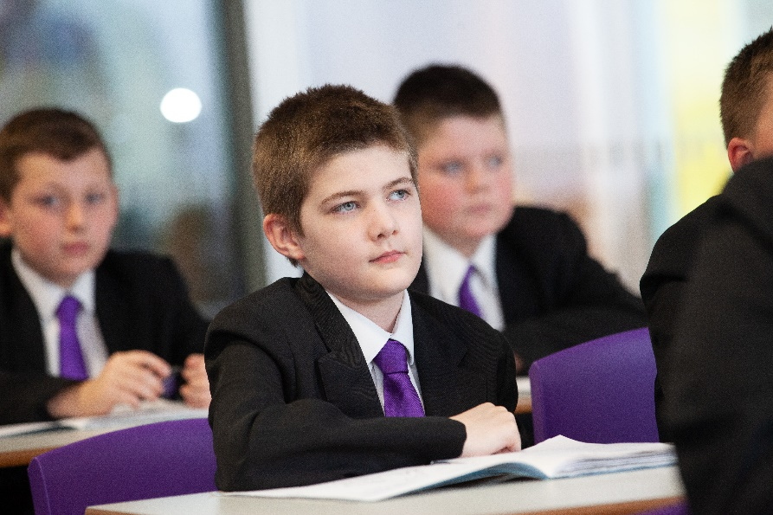
Our Mission
MAXIMISING OUR POTENTIAL

Slide 4
Our Vision
A community driven by high expectations and mutual respect providing all individuals with the belief and opportunities to succeed now and in the future

Slide 5
The Kirkby Child
Resilience
Confidence
Aspiration
Respect
Kindness

Slide 6
The Kirkby Code
Our curriculum for behaviour
Allow teachers to teach, and students to learn
Do things first time, every time
Be prepared to learn, with the correct equipment
Be respectful to others and our environment
Do all things to the best of my ability

Slide 7
Support Triangle

Slide 8
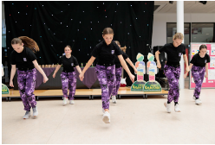
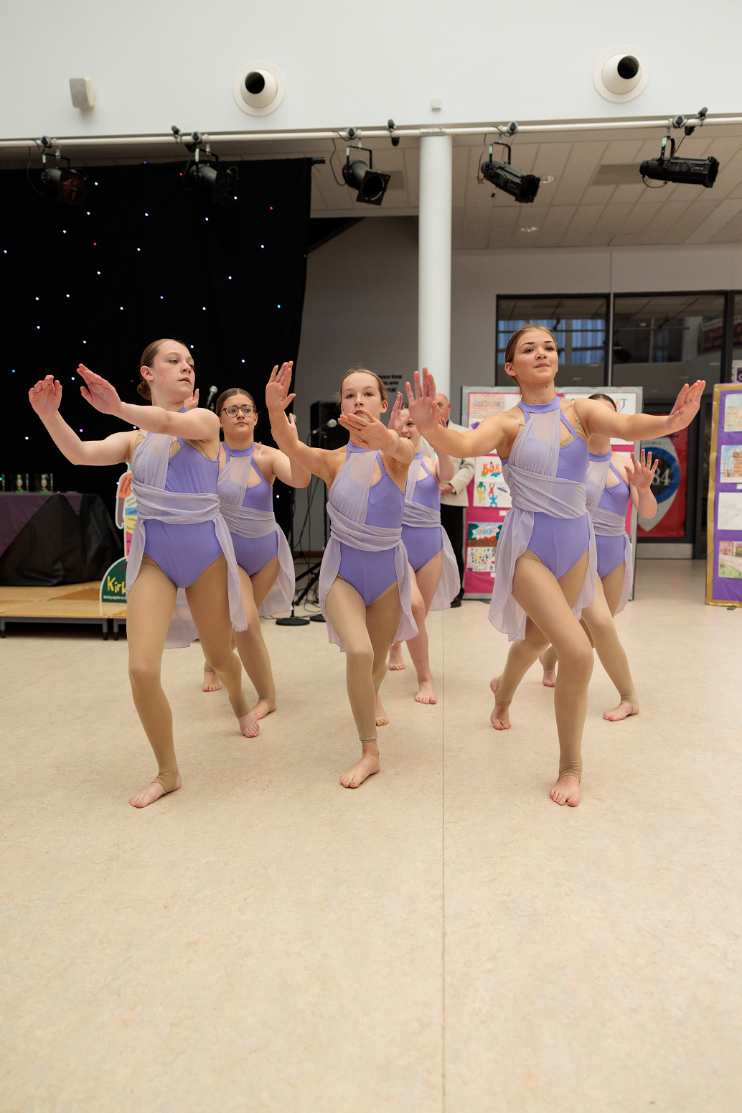
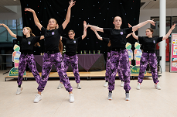
KHS Dance Club

Slide 9
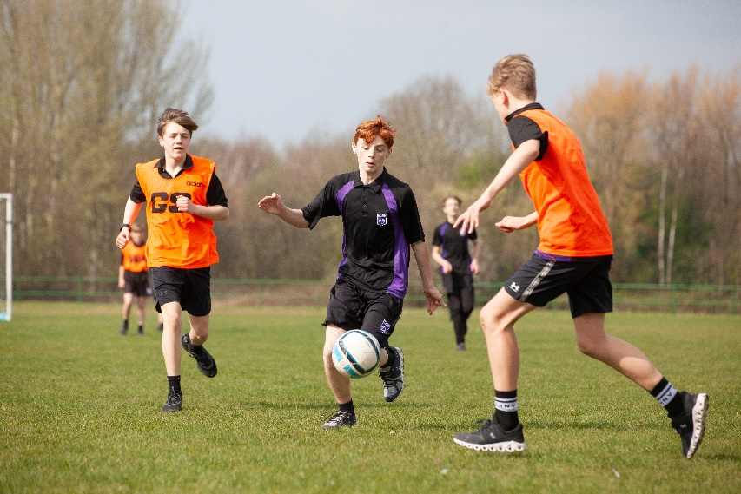
Attendance

Slide 10
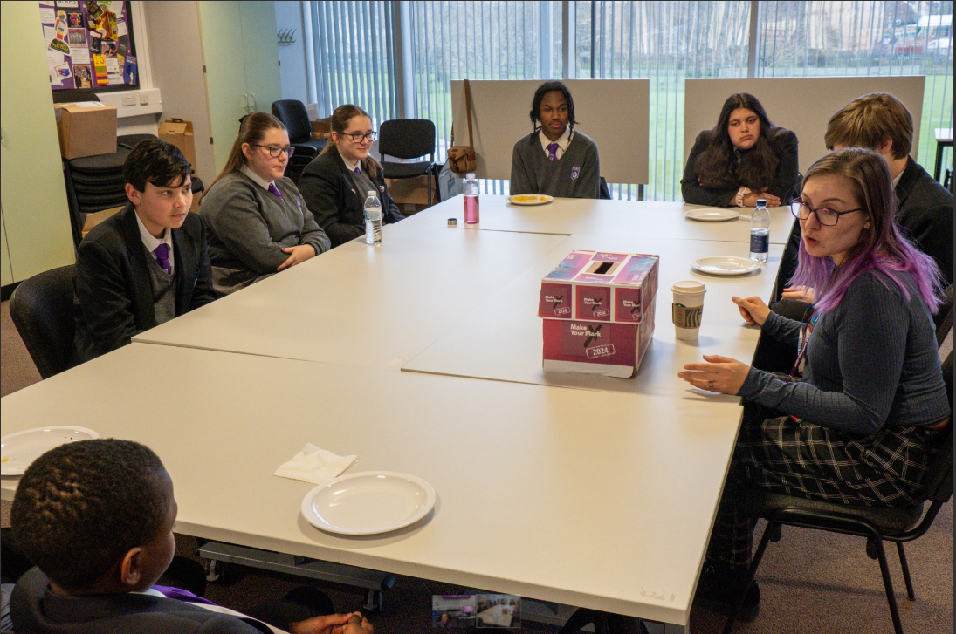
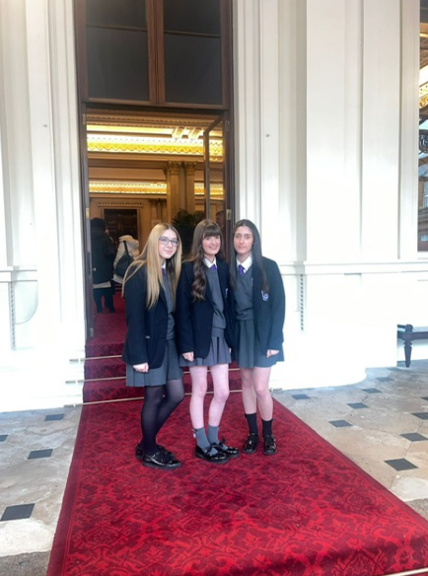
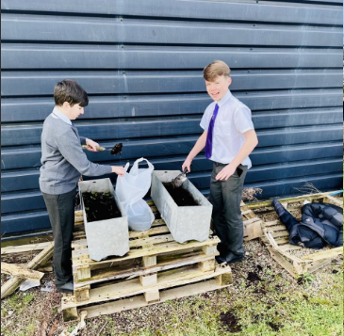
Opportunities

Slide 11
Important Dates
Friday 26th April – Welcome pack sent out
Wednesday 12th and 19th June – Additional transition afternoons for specific students
Thursday 20th June – Transition evening (4:00pm-6:00pm)
Friday 28th June – Transition day for all students

Slide 12
Thank You
If you have any further questions, please contact us:
Telephone: 0151 4778710
Email: transition@kirkbyhighschool.net

