Slide 1
World Mental Health Day
Intended Outcome:
Self-Esteem and Confidence
Wash your hands
Keep your distance from others
Catch it, bin it, kill it
Stay safe – First time, every time
REMEMBER!
It’s not who you are that holds you back. It’s who you think you’re not
Stay safe, seek success

Slide 2
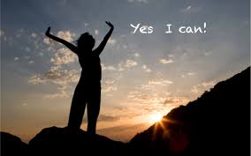
World Mental Health Day
How can self-esteem and confidence effect us
If we have high self-esteem, we feel good about ourselves. And if we feel confident, we feel like there are things we’re good at. But sometimes, our confidence gets knocked, or we don’t like ourselves very much.
We can all feel like this at times, but when we feel like this for a long time, it can become a problem.
Whatever affects your confidence or self-esteem, it's important to remember that you always have the right to feel good about yourself.
It’s not who you are that holds you back. It’s who you think you’re not
Stay safe, seek success

Slide 3
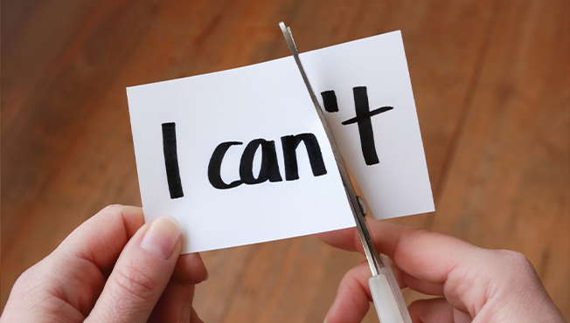
What is Self-esteem
Your self-esteem is how you think and feel about yourself. Your self-esteem can affect how much you:
like and value yourself as a person
believe in yourself and the things you can do
stand up for yourself when under pressure
are willing to try new or difficult things
move on from mistakes without blaming yourself unfairly
believe you matter and are good enough
believe you deserve happiness.
If you have high self-esteem, the way you think and feel about yourself is likely to be positive. But if you have low self-esteem, you may find that the way you think and feel about yourself is more negative, and you may feel less able to stand up for yourself.

Slide 4
What is Confidence
Confidence is about:
Believing in yourself, your abilities and ideas – this could be knowing a suggestion you have in class is a good one, believing in a new idea or hobby and pursuing it, or knowing you can start a conversation with someone new.
Understanding and accepting yourself for who you are – like being proud of your sexuality or hair colour, being okay with not being great at sports, or not wanting to change yourself to fit in with others.
Confidence doesn’t mean being ‘outgoing’. You can be quiet or shy and still be confident. And even when someone’s the loudest person in the room, that doesn't always mean they’re feeling the most confident inside.

Slide 5
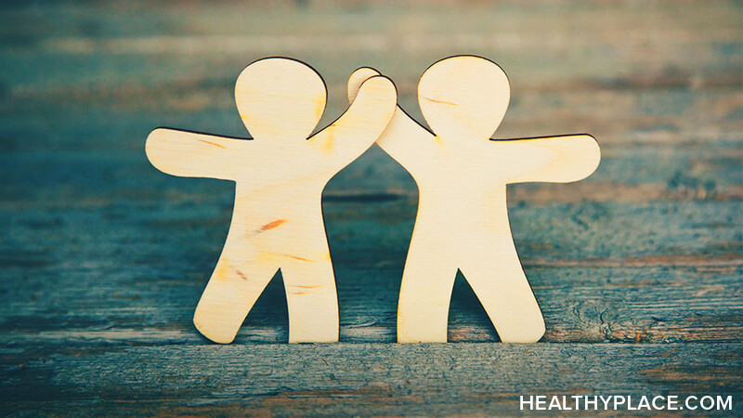
What can affect my confidence and self-esteem?
Negative experiences can lower your confidence and self-esteem, like going through a breakup or being teased about your appearance. And positive experiences can boost your confidence and self-esteem, like doing well on a test, getting a compliment on how you look, or doing something nice for a friend or neighbour.
What affects your confidence and self-esteem can be different for different people. These experiences might affect our confidence or self-esteem positively or negatively:
your results at school or college
social media or adverts
the level of support you receive from people you trust
your body image and how you feel about your appearance
your achievements or skills.

Slide 6
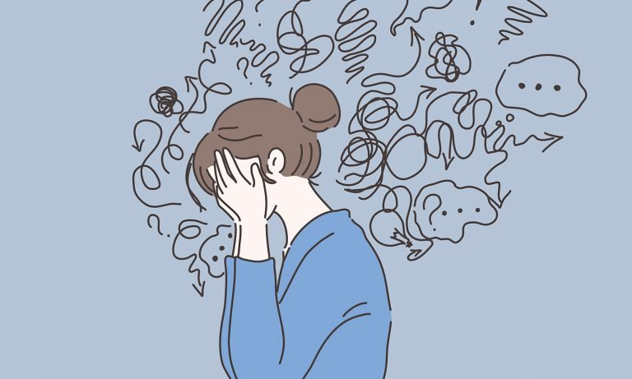
Other experiences may only negatively affect our confidence and self-esteem, such as:
Peer pressure to fit in
Experiencing stigma or discrimination
Being Bullied
Pressure to achieve in exams, sport or other hobbies
Family problems
You may be affected by other experiences that aren’t in these lists. Or you might have had low confidence or self-esteem for a long time, which can make it hard to understand why you're feeling this way.

Slide 7
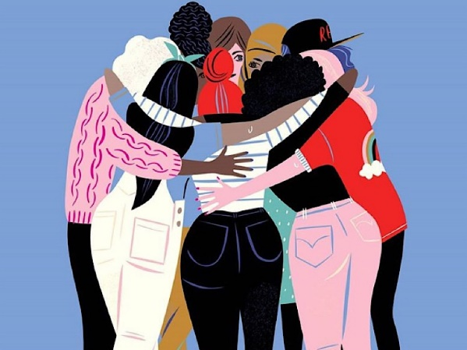
How can I build my confidence and self-esteem?
Top Tips
Be kind to yourself
Challenge critical thoughts of yourself and speak to yourself like you would do a friend.
Focus on the positives
Write down a list of things you have achieved and feel proud of.
Try something new
Trying something new can help you develop a skill and meet new people.
Talk to someone
It's important to speak to someone you trust about how you are feeling. Bottling up your feelings can sometimes make things worse.
Act confident even when you don’t feel it.
You could start by practising talking or a pose in your mirror, and work up to acting confident in front of others. But if you can keep it up, you may find after a while that you’re not acting any more.
Building your confidence and self-esteem can take time and practice. And what helps you now may not be the same thing as what helps in the future. But there’s lots of things you can do to improve the way you feel about yourself and your abilities.
It might feel like a big step to make changes. Start by trying a couple of new things each week, until you find what works for you. Go at your own pace and don’t put too much pressure on yourself – small changes can make a big difference.

Slide 8
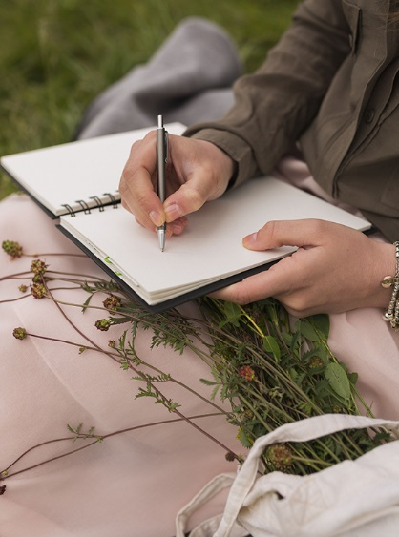
15-20 minute task
On your own, please write out each start of the sentence and then fill out the rest with your own words.
The aim of this is to help you to explore your thoughts and feelings, making it easier to share and open up if you wanted to, as well as creating a more positive outlook on yourself.

Slide 9
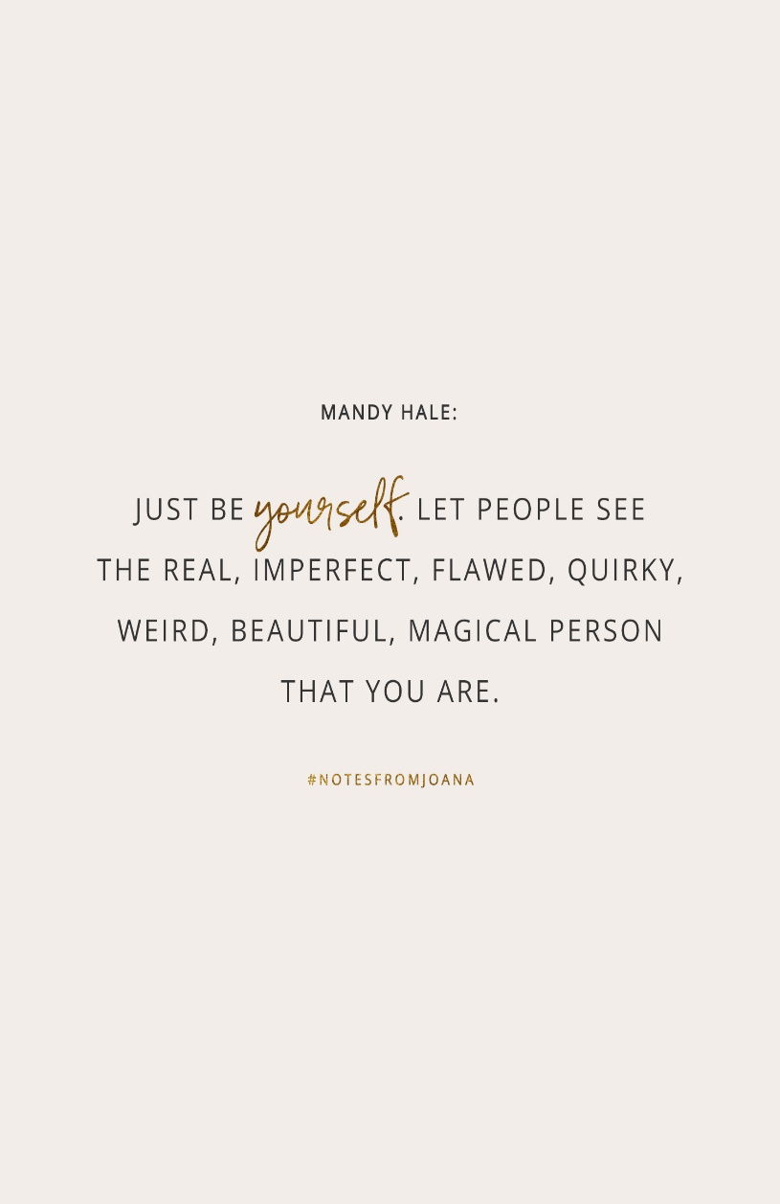
I like who I am because…
I’m good at…
I feel good about my…
Somewhere I feel happy is…
I mean a lot to…
Others reckon I’m a great…
Something I really enjoy is…
I really admire myself for…
My future goals are…
I know I can achieve them because I’m…
Others often praise my…
I have always wanted to…
It made me feel great when…
I find it hard to…
It makes me angry when…
I feel something that the future holds for me is…
If don’t get round to finishing all the sentences, just write them out and come back to it ☺

