Slide 1
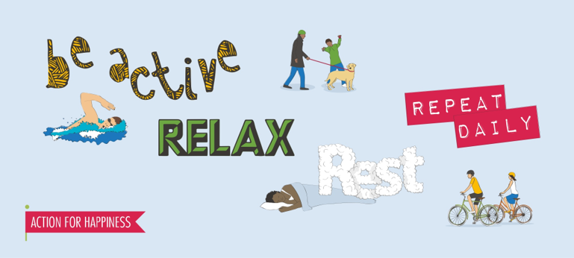
Exercising: Take care of your body
Physical activity has great benefits for our mental health.
A short walk can do wonders to boost happiness and even help us manage symptoms of depression.
There are lots of simple ways to incorporate movement into your daily routine.
Here are some ideas:
Get outside and do something active.
Put on a song you love and have a daytime dance party.
Set a timer to remind you to move every hour.
You don’t even have to go outside -- so if you’re stuck indoors you can still take time to breathe and stretch.
Today’s action:
What will you do today to be active?

