Slide 1
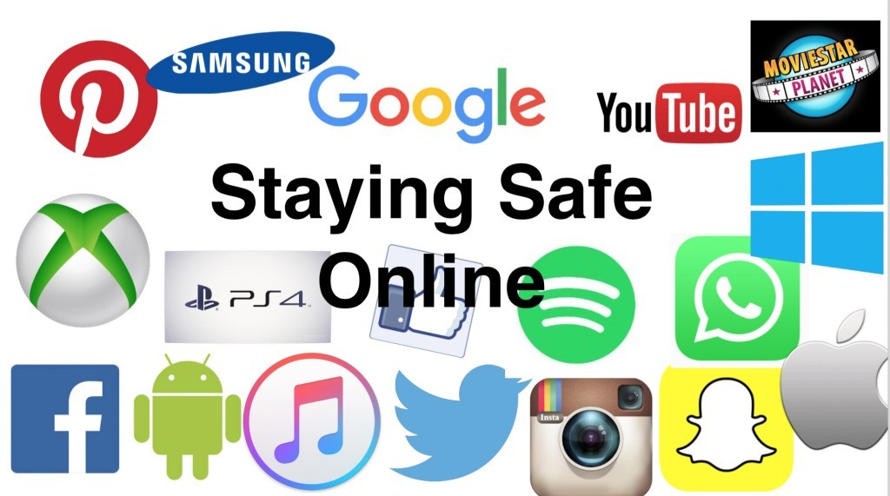
Staying Safe Online

Slide 2
Staying Safe Online
Keeps you safe from harm.

Slide 3
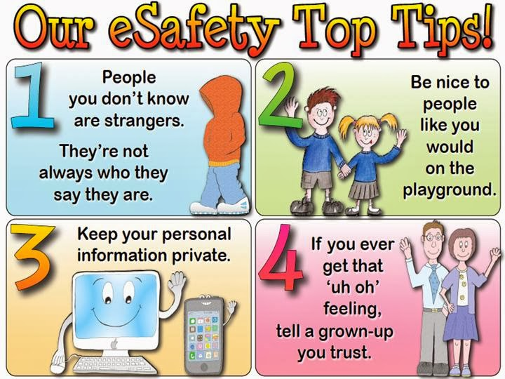
Staying Safe Online
The internet is an amazing place to be creative, chat with friends, play games and find interesting things to do. You may spend a lot of time online, so it’s important to make the most of it and enjoy it whilst also being safe, sensible and respectful of others too.
Here’s a guide to being smart about what you do online!

Slide 4
Staying Safe Online

Slide 5
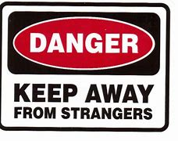
Staying Safe Online
Don’t ever give out:
Your Name
Your Phone Number
Your Address
Your Passwords
Your schools name
Your parents name
Any other identifiable information
If you are using social media check your privacy settings and make sure only friends can see your posts.

Slide 6
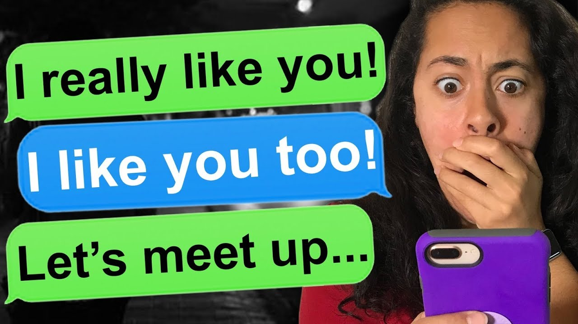
Staying Safe Online
If you’re speaking with someone you have never met, be aware that they may not be who they say they are. You wouldn’t speak to a stranger in the real world so don’t do it online! Never agree to meet up with someone you have met online.
Always tell a trusted adult who you are speaking with and if something doesn’t feel right – tell someone straight away!

Slide 7
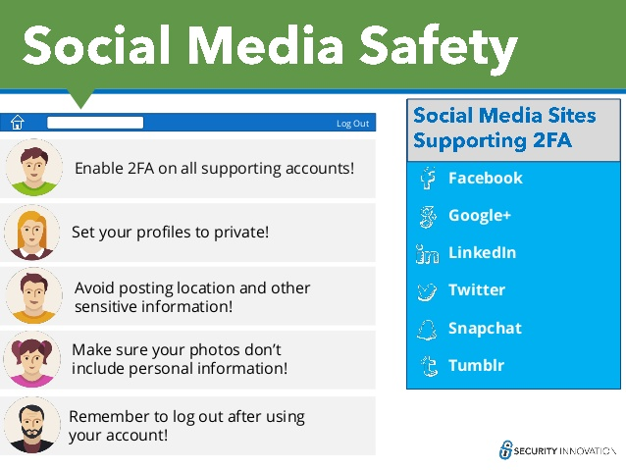
Staying Safe Online

Slide 8
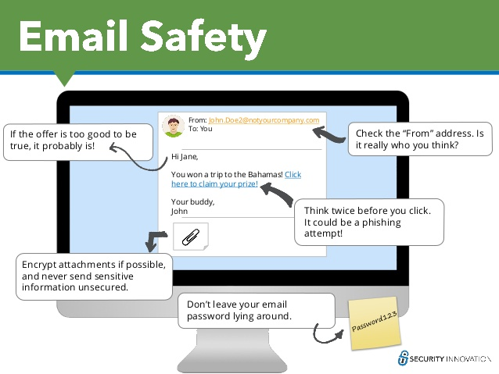
Staying Safe Online
Viruses: People can send viruses through emails which may either steal your personal information or infect your computer with viruses. Don’t open any emails you don’t recognise or click on any links!
Spam: Companies can find your email address and send you emails trying to sell you something. Try to avoid opening and clicking on any links in spam emails!

Slide 9
Staying Safe Online

Slide 10
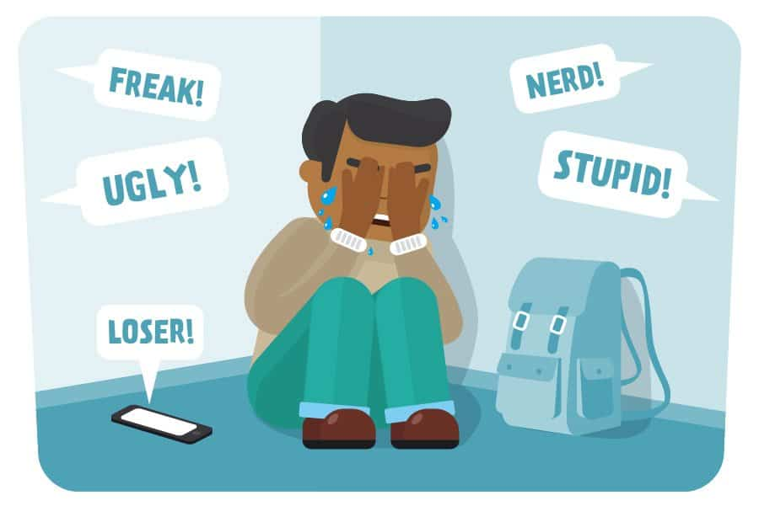
Staying Safe Online
Be respectful
Be respectful of your friends on online and on social media.
Don’t say or do anything to others which they may find hurtful or upsetting.
Don’t post things which others may find embarrassing such as photos or private
information.
Try to be mindful of how your posts will make other people feel before you put them up. If anyone does anything to upset you online – speak to a trusted adult straight away.

Slide 11
Staying Safe Online
The Internet is a powerful tool that helps us all learn and grow. It’s a big part of everyday life, but that doesn’t mean there shouldn’t be restrictions.
Setting time and place limitations on Internet usage is a great way to help keep you active, social, and safe!
Why not try?
Limiting your technology use
Removing technology from your bedroom
Learning a new hobby/skill
Doing some exercise

Slide 12
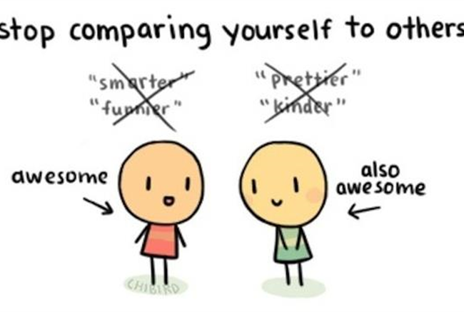
Staying Safe Online
And remember! It’s not always real life!
Always bear in mind that photos and posts can exaggerate real life. Think about it - we usually select the nicest, happiest pictures to post.
Images of other people’s (carefully chosen) images may leave you feeling low, but they don’t tell the whole story, so try not to compare yourself.
If you do find yourself feeling low or unhappy for a prolonged period of time, speak to someone you trust or get support from the following organisations.

