Slide 1
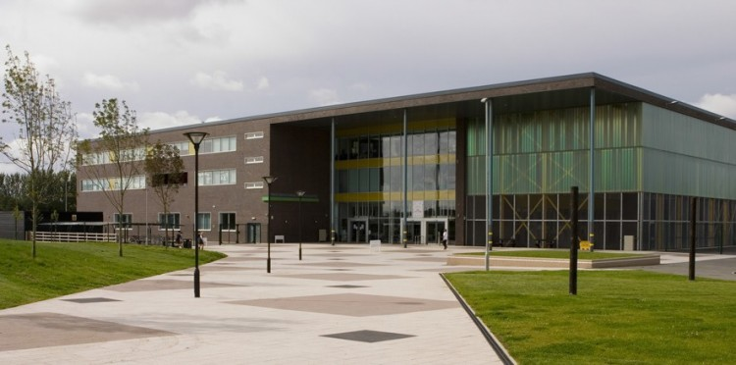
Year 9 Options
Good afternoon Year 9!
Today we will be exploring:
What the options process is all about
The qualifications on offer

Slide 2
Compulsory Subjects
At KS4, you will study:
English Language
English Literature
Mathematics
Science
Physical Education (non-GCSE)
Science Information
Most of you will study trilogy GCSE leading to two GCSE grades.
A small number of you will study separate sciences, leading to three GCSE grades. This can be discussed during your options meeting

Slide 3
Science
Separate Sciences (Triple)
Trilogy Award Science (Double)
Both courses include the study of Biology, Chemistry and Physics
Biology
Chemistry
Physics

Slide 4
What can you choose?
We aim to give you a free choice of subjects and then build the timetable around your choices:
List A- choose any two:
Art and Design
PE or Sports Studies*
Design Technology (Fashion and Textiles)
Computer Science
Dance
Design Technology (Resistant Materials)
Drama
Creative iMedia
Food and Nutrition or Catering*
Geography or Travel and Tourism*
RE
History
Music
Spanish
List B- choose one:
Computer Science
Geography
History
Spanish
You must select different types of subjects
* Vocational subjects
There may also be other vocational subjects available, which will be discussed on an individual basis at the options interview.

Slide 5
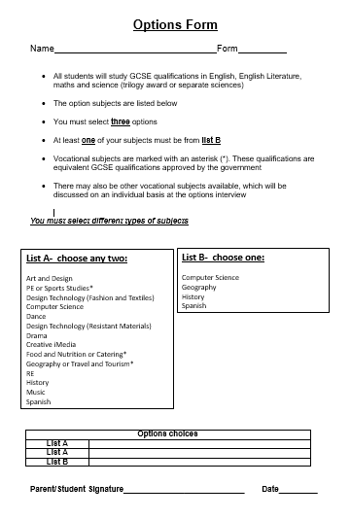
The Option Process
You need to make three choices from the subject list
At least one of your subjects must be from list B
These forms are available on the website and a copy has been posted to your home
The deadline is Friday 19th March
Further information regarding how to submit options selections remotely will follow

Slide 6
Options Interviews
You will have a meeting with Mrs Kenny, Mrs Turner or Mr Greenhalgh to discuss your options choices
These meetings will beginning on Monday 1st February and will be completed by Thursday 11th February
The time and date of your appointment is on the letter that has been posted home – please make sure you make a note of this
The meeting will take place on Microsoft Teams on the Year 9 team. Your parents and carers are welcome to join the meeting, however there is no requirement for them to do so
Every one of you will have an interview

Slide 7
Support
Teacher input – parents/carers can talk to form tutors during parents evening telephone call (w/c Monday 1st February 2021)
Options interviews – will take place with a senior member of staff (w/c Monday 1st February 2021)
Information from subject specialists – presentations giving details on individual options subjects will be available on the website from heads of faculty (w/c Monday 1st February 2021)
Independent advice – careers information and links are on the school website. You will also have a log in for the Unifrog platform. Please explore Unifrog for lots of careers guidance
School Website - the following information will be available on the school website: options booklet, options form, useful links to careers websites and this presentation

Slide 8
Our Advice…
Choose the subjects you are likely to do best in. Use the information in your reports and the feedback you have had from your teachers to guide you
Don’t make a choice just because you like the teacher. That teacher may well not be taking the group you end up in
Be realistic about your strengths and weaknesses and accept realistic advice about the type of course you choose
Do your research by reading the options booklet thoroughly and talking to your teachers
Above all don’t choose a subject because your friend is doing it! There is no guarantee you’ll end up in the same class!

Slide 9
Options –
Things to consider
Do your research; ask questions, get advice, read what is involved e.g. essays, control assessment, practical, creative, problem solving, research, analytical, sports, performing….
Consider what you are thinking of studying after year 11 (college, apprenticeships, training courses and university requirements)
Consider what relates to any career ideas you have
GCSE requirement for maths and English. You will need to resit these if you do not achieve grade 4 at school
Do choose what is right for YOU and strike a balance

Slide 10
The New GCSE Grading
As a guide the numbers are broadly equal to the old grades shown below:
‘Standard’ GCSE Pass
‘Strong’ GCSE Pass
New Numbers | 1 | 2 | 3 | 4 | 5 | 6 | 7 | 8 | 9
Old Grades | G/F- | F/E | E+/D | C | C+/B- | B/B+ | A | A* | A**
This system affects all GCSE subjects.
There are, however, a number of vocational subjects that are graded differently:
‘Standard’ GCSE Pass
‘Strong’ GCSE Pass
 | Level 1 |  |  | Level 2
Grade | Pass | Merit | Distinction | Pass | Merit | Distinction | Distinction*
GCSE Equivalent | 1 | 2 | 3 | 4 | 5/6 | 7 | 8

Slide 11
EBacc
The EBacc (English Baccalaureate) is a recognition of a good pass at GCSE, which means gaining a grade 5 or higher in the following subjects:
English Language and English Literature (Compulsory)
Maths (Compulsory)
Science (Trilogy or Separate) (Compulsory)
A Modern Foreign Language (Optional)
History or Geography (Optional)
Computer Science* (Optional)
*If the separate sciences option is chosen, to count as science in the EBacc, three out of four single sciences must be taken in physics, chemistry, biology and computer science.

Slide 12
University choices
The Russell Group is made up of the following universities:

Slide 13
What happens next?
Telephone calls will take place with form tutors beginning Monday 1st February 2021
Options interviews take place from Monday 1st February – Thursday 11th February 2021
Information from the head of faculty of each options subject will be available to view on the website from Monday 1st February
A careers assembly on Tuesday 9th February 2021 at 3pm with Mrs Kenny
Options deadline Friday 19th March 2021

