Slide 1
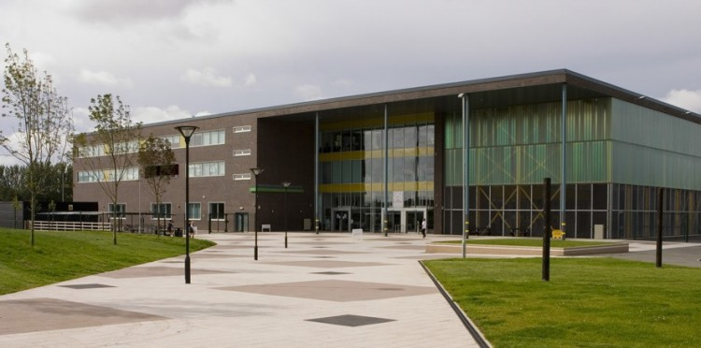
Year 9
Options Booklet
January 2021

Slide 2
Contents
Content | Page
Introduction | 3
What subjects will I study? | 4
The Options Process | 5
Key GCSE Information | 6
Compulsory Subjects
English Language and Literature | 8
Mathematics | 9
Science | 10
Optional Subjects
Art and Design | 11
Catering | 12
Computer Science | 13
Creative iMedia | 14
Dance | 15-16
Design Technology | 17
Drama | 18
Fashion and Textiles | 19
Food and Nutrition | 20
Spanish | 21
Geography | 22
History | 23
Music | 24
Physical Education | 25
Religious Education | 26
Sport Studies | 27
Tourism | 28
Notes | 29

Slide 3
Introduction
We understand the importance of supporting your child through the choices in Year 9 as this determines their journey into the next stage of their time in education.
Our options process is designed to provide advice and guidance to both you and your child to make informed decisions about the subjects they will study for the next two years.
Choosing your subjects
You should choose subjects that you enjoy and will achieve good grades in. This means that you need to do your research into what the subjects will be like in Years 10 and 11. This booklet has been designed to give you three key pieces of information about the options process.
Information about the subject choices on offer
Information relating to the content of each course
How each course is assessed
You need to read the booklet carefully and use this information to help you make your decisions. You may find it useful to rank the subjects that you like so you know what your top three choices are before you attend the options interview.
Use this checklist to make sure you have given enough thought to your choices:
Read the options booklet thoroughly and research all your options before you make a decision
Take some time to consider what you might want to do when you leave Kirkby High School. If you have a firm idea about a career or about subjects you may want to study post-16 then choose these options
If you don’t have a firm idea about what you want to do post-16, choose options that will give you plenty of choice post-16
Don’t be afraid to ask for advice from teachers, friends, family or students that are currently studying subjects you are thinking about choosing – you cannot have too much information to help you make your choices!
Good reasons for choosing an option:
You are good at the subject
You think you will enjoy the course
It fits your future career ideas and plans
It goes well with your other choices
You think you might want to continue studying it post-16
Your research shows that it will interest you and motivate you to learn
Bad reasons for choosing an option:
Your friends have chosen it
You think it will be easy
You think it is a good option for a boy/girl
Someone else thinks it is a good idea
You like the teacher you have now
You did not research your options properly and don’t know enough about the subject

Slide 4
What subjects will I study?
Compulsory Subjects
At KS4, all students must study:
English Language
English Literature
Mathematics
Science
Physical Education (non-GCSE)
Science Information Most students will study Trilogy GCSE leading to two GCSE grades.
A small number of students will study Separate Sciences, leading to three GCSE grades. This can be discussed during your options meeting.
Option Subjects
The option subjects are listed below. At least one of your subjects must be from list B. Vocational subjects are marked with an asterisk (*). These qualifications are equivalent GCSE qualifications approved by the government.
There may also be other vocational subjects available, which will be discussed on an individual basis at the options interview.
NB: It will not be possible to select subjects of the same nature, such as Sport Studies and Boys’ PE, for example. You must select different types of subjects.
List A- choose any two:
Art and Design
PE
Fashion and Textiles
Computer Science
Dance
Design Technology
Drama
Creative iMedia
Food and Nutrition
Geography
RE
History
Music
Spanish
Catering*
Sports Studies*
Travel and Tourism*
List B- choose one:
Computer Science
Geography
History
Spanish

Slide 5
The Options Process
Options Interview
Every student will have an options interview with a senior member of staff. In this interview, staff will discuss the student’s current grades, along with their attitude to learning. Based on this, students can be guided into selecting the subjects in which they are most likely to achieve, with a focus also on future career options. Parents and carers are more than welcome to attend this; however, there is no requirement to do so.
Advice to Students
These choices are very important because your grades at GCSE are your ‘passport’ to future education or employment. Make sure you:-
Choose the subjects you are likely to do best in. Use the information in your reports and the feedback you have had from your teachers to guide you
Don’t make a choice just because you like the teacher. That teacher may well not be taking the group you end up in.
Be realistic about your strengths and weaknesses and accept realistic advice about the type of course you choose.
Above all, don’t choose a subject because your friend is doing it. There is no guarantee you will be in the same class.
The majority of students will study the 3 subjects they choose, however there are always some students whose choices cannot be accommodated. In these cases, students will be re-interviewed and asked to re-select one of their choices.
A note about the English Baccalaureate (EBacc)
This is not a separate qualification, but students who gain “good passes” in all of the subjects listed below will be able to state that they have the Ebacc. Good passes means gaining grade 5 or higher in:
English Language and Literature
Mathematics
Science / Computer Science
A foreign language and
Either History or Geography
Only these 5 GCSEs will count towards the Ebacc. We have spoken to local Further Education providers and Universities who both say that at present there are no plans to use the EBacc as a discriminator when considering applications. There is no guarantee however that it will not be used in the future.

Slide 6
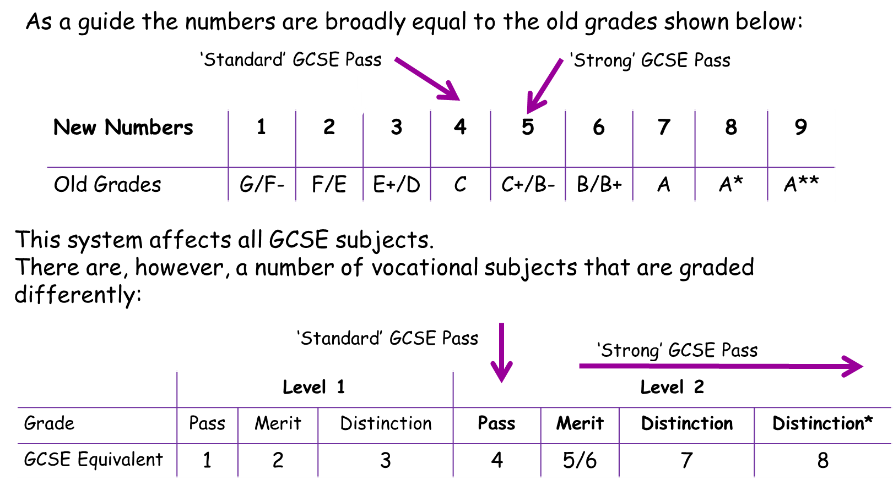
Key GCSE Information
GCSE Grading System
The Government introduced a new GCSE grading system in September 2015 and this system has been phased in for different subjects since then. This new system removed the A*-G grading system and replaced it with a system based on numbers 1-9, where 1 is the lowest grade and 9 the highest. This system now affects all GCSE subjects and means your child will receive all their GCSE results as numbers.
The old lettered grades do not completely correspond with the new numbered system. A rough guide to how the new grades compare is shown in the table below:

Slide 7
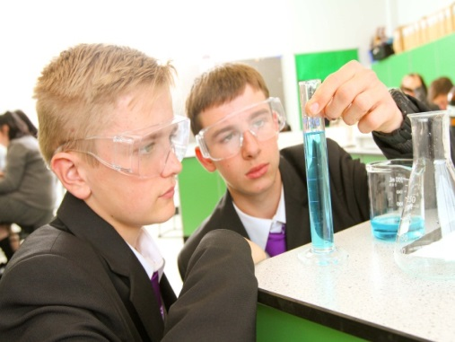
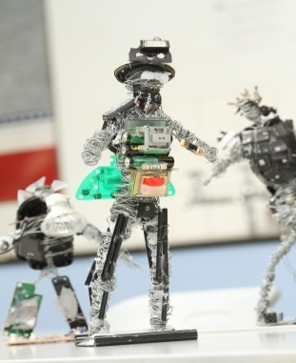
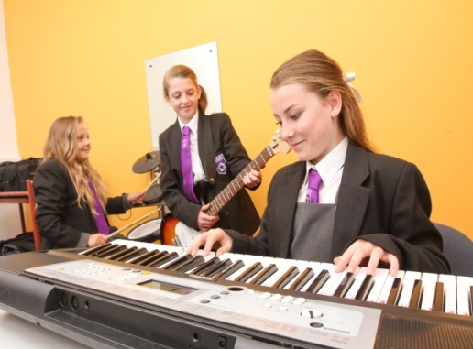
In this section, you will find information on both the compulsory and option subjects available to your child. It is important that you read each section carefully and consider the requirements of each qualification to ensure that it best suits your child’s abilities and future plans.

Slide 8
English Language & Literature
(2 GCSEs)
English is essential in all areas of life. Studying English will develop your reading, writing, speaking and listening skills to enable you to progress to further study post-16 and the world of work.
You will be encouraged to develop sensitivity and understanding in appreciating well-known works of literature, both in exploring all facets of the writer’s expression and in linking your own experiences with what you have read.
Ideally, you will not merely achieve two GCSE grades but will develop a broad and questioning mind that can challenge conventional ways of thinking and explore the world reasonably, independently and with confidence through command of the written and spoken word.
GCSE English language:
Narrative writing
Reading literary texts
Reading non-literary texts
Transactional writing
Speaking and listening
GCSE English literature:
‘A Christmas Carol’ by Charles Dickens
‘Blood Brothers’ by Willy Russell
Selected poetry – anthology and unseen
‘Macbeth’ by William Shakespeare
GCSE English language:
100% examination
GCSE English literature:
100% examination
Mrs R Kelly – Head of English Faculty

Slide 9
Mathematics
The mathematics course provides students with the opportunity to develop confidence in, and a positive attitude towards, mathematics and to recognise the importance of mathematics in their own lives and to society. This qualification prepares students to make informed decisions about the management of money, further learning opportunities and career choices. Elements of mathematics are used in all careers and some fields require daily and skilled use of mathematical concepts, such as science, business and accountancy. The mathematics faculty believes in a positive and wide ranging approach to developing a pupil’s understanding of mathematics. We strive to create resilient individuals who can set goals for themselves, face challenges, and endeavor to overcome them.
All members of staff encourage students to maximise their full potential in the subject and aim to stimulate and enthuse students to pursue further studies in mathematics. Research tells us that students who study ‘A’ level mathematics and then go on to study a mathematics based degree at University become some of the highest earners in the country.
All students will follow a linear GCSE scheme of work which covers all aspects of mathematics including:
Number
Algebra
Ratio, Proportion and Rates of Change
Geometry and Measures
Probability
Statistics
The mathematics GCSE is assessed using three separate examinations, two with the use of a calculator and one without. Each exam lasts 1 hour 30 minutes. There are two tiers of assessment: Foundation (grades 1-5) and Higher (grades 4 -9).
Students are entered at the tier appropriate to their attainment and the school will recommend the level of entry.
Mrs. C Frodsham - Head of Mathematics Faculty

Slide 10
Science
(2 GCSEs)
This course is completed over 2 years with the content being examined at the end of Year 11. It contains 2 papers for each component of the sciences (biology, chemistry and physics) with a total of 6 examinations. This course will be studied by all GCSE classes apart from those studying separate science.
Biology:
Paper 1: The units studied include Cell biology, Organisation, Infection and response and Bioenergetics.
Paper 2: The units studied include Homeostasis and response, Inheritance, variation and evolution and Ecology
Chemistry:
Paper 1: The units studied include Atomic structure and the periodic table, Bonding, structure and properties of matter, Quantitative chemistry and Energy changes.
Paper 2 The units studied include The rate and extent of chemical change, Organic chemistry, Chemical analysis, Chemistry of the atmosphere and Using resources.
Physics:
Paper 1: The units studied include Energy, Electricity, Particle model of matter and Atomic structure.
Paper 2: The units studied include Forces, Waves and Magnetism and Electromagnetism.
The course contains 6 individual exams each lasting 1 hour 15 minutes.
There are 70 marks available on each paper and each has a mixture of multiple choice, structured, closed short answer and open response questions.
The papers can be taken at foundation or higher level and will lead to two qualifications.
Mrs. S. Bennett-Jones - Head of Science Faculty

Slide 11
Art and Design
If you have enjoyed your art lessons in KS3, have a genuine interest in art and design, are self-motivated, and prepared to work independently in your own time, then you should consider opting for art and design.
Art is very successful at Kirkby High School with a high percentage of students achieving good GCSE results.
During the course, you will study topics such as fashion illustration, graphic design, illustration, large scale oil pastel, watercolour and acrylic compositions, still life studies and photography with Photoshop.
You will be assessed on four areas of study:-
• Artist reference and cultural connections.
• Experimenting with media and equipment.
• Exploring ideas, recording and annotating ideas.
• Your personal response, including the final piece.
Coursework
The course follows the AQA syllabus which will require a portfolio of work that consists of coursework representing 60% of the final grade. You will also be required to sit a timed, (10 hour) externally set task that represents the other 40%.
Students should be aware that within the new syllabus there is a strong emphasis on drawing and written work.
Externally Set Task
In Year 11 students receive an externally set task by the exam board, AQA. They are given several weeks of preparation time to independently develop ideas in preparation for a ten hour exam where they produce a personal response to their chosen starting point. The ten hours are spread over two days.
Mrs. D Cunningham - Head of Art and Head of Creative Arts Faculty

Slide 12
Hospitality and Catering
Students will gain knowledge, understanding and skills required to cook and apply the principles of nutrition and healthy eating. It encourages students to cook, enables them to make informed decisions about food and nutrition and allows them to acquire knowledge in order to be able to feed themselves and others affordably and nutritiously, now and later in life. It is an ideal course for students who may choose a career in the Hospitality and Catering Industry.
The course will give students the opportunity to:
• Demonstrate effective and safe cooking skills by planning, preparing and cooking a variety of food.
• Develop knowledge and understanding of the functional properties and chemical characteristics of food as well as a sound knowledge of the nutritional content of food and drinks.
• Understand the relationship between diet, nutrition and health, including the physiological and psychological effects of poor diet and health.
• Understand and explore a range of ingredients and processes from different culinary traditions (traditional British and international) to inspire new ideas or modify existing recipes.
• Prepare and cook a range of recipes using a variety of skills and equipment.
• Present food to restaurant standard using appropriate garnishing ingredients and techniques.
Unit 1 - The Hospitality and Catering Industry Exam 40%
Unit 2 - Hospitality and Catering in Action Coursework 60%
Mrs. A Adamson- Head of Technology Faculty

Slide 13
Computer Science
The world is changing and with that there is an increased dependency on computers. GCSE computer science is a great choice for students who want a challenge. This GCSE in computer science encompasses programming skills and theory about how a computer operates.
Computer science should encourage candidates to be inspired, moved and challenged by following a coherent, satisfying and worthwhile course of study. They should help students to gain an insight into related sectors such as the programming industry. It is here skills will be ignited that with further study could open up excellent career opportunities with some of the world’s leading technology companies such as Google and Apple.
1. Acquire and apply knowledge, technical skills and an understanding of the use of algorithms in computer programs to solve problems using programming.
2. Develop computer programs to solve problems.
3. Develop the skills to work collaboratively to write code.
4. Understand the mechanics of a computer and how they operate.
5. Evaluate the effectiveness of computer programs/solutions and the impact of, and issues related to, the use of computer technology in society.
Paper 1: Computer systems written assessment – 50% of the GCSE qualification
This component will assess: Systems architecture, Memory and storage, Computer networks, connections and protocols, Network security, Systems software, Ethical, legal, cultural and environmental impacts of digital technology.
Paper 2: Computational thinking, algorithms and programming written assessment – 50% of the GCSE qualification
This component will assess: Algorithms, Programming fundamentals, Producing robust programs, Boolean logic, Programming languages and Integrated, Development Environments
Practical programming
All students will be given the opportunity to undertake a series of programming tasks, to solve given problems, this will give student’s ability to use the knowledge and skills gained through the course in a practical programming setting. Students will be expected to follow a systematic approach to problem solving using consistent skills. You will be asked to design a computer program create the computer programming code itself and test it solves the problem.
Mr. I Flynn - Head of Computing Faculty

Slide 14
Creative iMedia
The Cambridge National qualification in Creative iMedia is a media sector focussed qualification. If you have an interest in film, television, web development, gaming or animation then this is a suitable qualification for you.
Pre-Production Skills; this unit allows learners to understand pre-production skills used in the creative and digital media sector. Students will understand the purpose and uses for mood boards, storyboards, mind maps and visualisation diagrams. The knowledge and skills learnt in this unit will be applied to all other units.
Creating digital graphics; digital graphics feature in many areas of our lives and play an important part in today’s world. The digital media sector relies on these visual stimulants within the products it produces to communicate products effectively. In this unit you will be asked to create a digital graphic.
Two other units will be selected to study in depth. These can be chosen from creating 2D and 3D characters, storytelling with a comic strip, creating a website, creating animation, creating multimedia products, creating digital sound, creating digital video, photography or developing digital games.
Pre-Production Skills is assessed through a written paper of 1 hour 15 mins. This is set and marked by the examination board. This unit is worth 25% of the total qualification.
Creating digital graphics is assessed through a controlled assessment task. This is a practical unit that is completed in class. This is marked by your class teacher and then sent to the exam board for verification. This unit is compulsory and is worth 25% of the total qualification.
A further two units must be completed these can be selected from creating 2D and 3D characters, storytelling with a comic strip, creating a website, creating animation, creating multimedia products, creating digital sound, creating digital video, photography or developing digital games. These are practical units and are worth 25% each of the total qualification.
Coursework and/or Examination Final Assessment
1 Exam and 3 Controlled Assessments Examination 25%
3 Controlled Assignment units 25% each
Mr. I Flynn - Head of Computing Faculty

Slide 15
Dance
“Great dancers are not great because of their technique; they are great because of their passion” Martha Graham.
If you have a passion for dance you should consider studying it at GCSE level. You will need to be committed, enthusiastic and have some dance experience from outside of school and also be prepared to invest time and effort to independent rehearsal at lunchtimes and after school. In lessons you will need to be confident to explore your ideas and work both on your own and with others. You will need to regularly share your work with, and perform to, the rest of the class.
Studying GCSE dance will help you to develop your confidence in performance and choreography as well as your dance technique. You do not have to have studied dance outside of school but this would be helpful.
Those studying GCSE dance may consider going on to study A Level dance at college or continuing on to do a further qualification in Performing Arts. Some may choose to study it purely for their love of dance.
The course consists of practical and theoretical work. The 3 main elements are; Performance, Choreography and the appreciation of professional works.
Performance
You will be required to learn a series of set phrases which you will perform as a solo lasting around 1 minute. You will also work, with others in the class, on learning a duet/trio piece that will last for 3 to 3 ½ minutes. You will gain marks for the accuracy of your movements, timing and sense of style as well as how engaging you are to the audience. You must learn about and demonstrate safe working practice and will focus heavily on performance skills, technique and expressive skills.
Choreography
You will use actions, dynamics, space and relationships to learn how to develop motifs and how to use them to choreograph effective and creative pieces. You will be required to choreograph, using your own ideas, both a solo or a group piece based on your own ideas and research.
Critical Appreciation of Dance
You will study, in detail, 6 professional dance works. You will look at the styles of dance used, the movement material, production features, costume, music and the context of the piece. You will need to describe, evaluate, analyse and compare the pieces studied.

Slide 16
Dance
Continued
The assessment of this course is split into 2 components
Component 1: Performance and Choreography (60% of final grade)
Performance | Solo performance of set phrases | 1 minute | 30 % of GCSE (40 marks) | 15 marks | Performed on moderation day to external moderator
 | Duet/Trio performance | 3-3 ½ minutes |  | 25 marks
Choreography | Solo or group choreography | Solo 2-2 ½ minutes Group 3-3 ½ minutes | 30% of final mark (40 marks) | 40 marks | Performed on moderation day to external moderator
Component 2: Dance appreciation
Dance appreciation | Written exam paper | 1 hour 30 minutes | 40% of GCSE (80 marks) | Questions based on students own practice in performance and choreography components and the 8 professional dance works studied
Coursework and/or Examination
See above
Final Assessment
All tasks within component 1 will be assessed in practical lessons throughout year 10 and 11. These will then be revisited towards the end of year 11 where they will perform live to an external moderator for final assessment.
Component 2 will be assessed by a written exam at the end of year 11.
Miss. N Hamer – Deputy Head of PE Faculty

Slide 17
Design Technology
The specification sets out the knowledge, understanding and skills required to design and manufacture a resistant materials product. Students will develop a variety of practical skills through mini projects to prepare them for their final product in Year 11. A large amount of theory is covered in practical lessons as well as through ICT. This will include materials research, as well as CAD/CAM packages including: Google sketch-up and 2D Design.
Practical lessons - Students develop a range of practical skills alongside core Computer Aided Design (CAD) skills. Students will also have the opportunity to use the school’s laser cutter.
Theory lessons - Using ICT students will acquire knowledge on the specification topics, this is to equip students with the knowledge required for their written examination. Theory topics are focused around materials, processes and manufacturing.
50% Controlled assessment task.
The students start their coursework in June of Year 10. This project will run into Year 11 and will focus on the following areas:
Designing - including drawing and computer aided design.
Making - including a range of techniques.
Testing and evaluating the completed product.
50% Written examination at the end of Year 11.
Section A - Core principles based on all areas of Design and Technology.
Section B - Specialist principles based on materials, components and manufacturing processes.
Section C - Tests the designing capability of the students.
Mrs A Adamson - Head of Design Technology

Slide 18
Drama
The course provides students with the opportunity to develop previous learning whilst exploring drama and developing a love for the theatre. Learners are able to demonstrate their skills as performers, and analyse/evaluate drama in writing.
This is a performance based subject – all students are required to perform and will be filmed for examination.
This new specification has a greater emphasis on written response than in previous years.
Units of work that the learners will study include:
Exploring play texts
Theatre in education
Actors workshops
Devising workshops.
Exploration of key practitioners.
GCSE Drama aims to give students the opportunity to develop:
Creative and imaginative powers and the practical skills for communicating and expressing ideas, feelings and meanings in drama
Knowledge and understanding of drama within a social, cultural and historical context.
Inter-personal and group working skills
Creative and performance skills
Improvisation skills
Communication and evaluative skills
A wider understanding of the performing arts, including the technical aspects of sound, lighting, makeup, costume and set design.
The course consists of units of work especially created to enhance and develop performance skills and prepare the learners for practical examinations. Over the course, learners will take part in two performances as an actor.
Component 1 is a devised performance and devising logbook (internally assessed 40%).
Component 2 is a live performance of two extracts of a published play (externally assessed 20%).
Component 3 is a written exam (40%)
Students are expected to attend at least one live theatre performance throughout the two year course as they have to write a theatre review as part of their written examination.
Mr. A Walker- Head of Drama Faculty

Slide 19
Design Technology Fashion and Textiles
The specification requires students to develop their ability to make textiles products. Over the two years, students will develop their practical and theory knowledge to successfully manufacture textile products and to acquire knowledge of a range of different materials. During Year 10, students will focus on developing their making skills on a range of different projects. In Year 11, students will complete their Non Examined Assessment portfolio as well as the preparation for their exam at the end of Year 11.
Students start the course learning basic textiles and sewing techniques. Students will then have opportunity to develop skills through the design and making of fashion and textile products.
Theory lessons cover a range of design and technology topics, different materials and processes.
50% Controlled assessment task.
The students start their coursework in June of Year 10. This project will run into Year 11 and will focus on the following areas:
Designing - including drawing and computer aided design.
Making - including a range of techniques.
Testing and evaluating the completed product.
50% Written examination at the end of Year 11.
Section A - Core principles based on all areas of Design and Technology.
Section B - Specialist principles based on materials, components and manufacturing processes.
Section C - Tests the designing capability of the students.
Mrs A Adamson - Head of Design Technology

Slide 20
Food and Nutrition
This GCSE course builds on work introduced in Years 7, 8 and 9. The course involves the following key principles: nutrition and health, food commodities, meal planning, food preparation and cooking, food safety and preservation.
Do you enjoy preparing, cooking and tasting food? Are you interested in learning about different ingredients and food products? Do you want to know where our food comes from? Well this could be the subject for you. Work in Food and Nutrition also provides opportunities to develop research, ICT, analytical, design and practical skills. Practical work plays an integral part in class work and coursework - which is a bonus!
In addition to developing the organisational and practical skills we all need in everyday life, this subject would obviously be useful for those who want to progress to careers within the food industry. It also appeals to those who are interested in working in careers linked to food and nutrition, such as sports nutrition, health related jobs and possibly even marketing and advertising.
The theory side to the subject will be based on the main principles of Food and Nutrition. A lot of the content is learnt through practical lessons. Students will need to provide their own ingredients and will be cooking on a regular basis.
For the controlled assessment tasks, students will be given a title by the exam board. First they will do some appropriate research linked to the title in order to help them decide on what to cook. Students will then plan their practical assessment; cook it; evaluate the sensory attributes and finally conclude the task.
50% Written exam: 1 hour 45 minutes
50% Coursework: Making and written tasks
Mrs. A Adamson – Head of Technology Faculty

Slide 21
Spanish
Spanish is one of the world’s most widely spoken languages and is spoken in a variety of countries worldwide. The GCSE Spanish course covers many of the necessary skills for the global workplace as well as essential Spanish for when you are on holiday.
More and more companies are looking for people with a qualification in a foreign language. A recent survey by the Confederation of British Industry confirmed that European languages, Spanish being one language in particular, are highly sought after by employers. The CBI's survey reported that 36% of employers recruit employees specifically for their language skills.
Knowing a foreign tongue and applying it tastefully is undeniably attractive. It implies education, good taste and refinement, and it will certainly make you stand out against the competition.
GCSE Spanish is a two year course leading to one GCSE grade.
Topics include: personal details, free time, healthy living, home town, work and education, future careers, technology, travel and holidays, social issues and cultural awareness.
GCSE Spanish has a Foundation Tier (grades 1-5) and a Higher Tier (grades 4-9).
Students must take final exams at the end of Year 11 in listening, reading and writing. Each paper is worth 25% of the final GCSE grade. Speaking is in the form of a non-exam assessment which will take place towards the end of Year 11. Again, it is worth 25% of the final grade. Students have to take part in a role play, photo card and a general conversation with their class teacher.
Miss. G Suthers - Head of MFL

Slide 22
Geography
Geography is about understanding the world’s people, places and environments. It illuminates the past, explains the present and prepares us for the future. What can be more important than this?
Geography is one of the most popular option choices at GCSE with over a third of students in England taking the subject. Geography is not only up-to-date and relevant, it is one of the most exciting, adventurous and valuable subjects to study at GCSE level. So important, in fact, that the Guardian newspaper in 2015 named Geography as a ‘must-have GCSE and A-Level’ to help you make sense of the world.
If you are not sure about what you want to do in the future, Geography helps to keep your options open. It is a subject that goes well with the Sciences and Mathematics as well as the Humanities, Languages and Arts. It is very flexible in terms of what it can be combined with both at GCSE and A Level.
The course is split into three sections:
Unit 1 – Natural Hazards, Ecosystems including Rainforests and Extreme Environments, and either Coasts or Rivers or Glaciers
Unit 2 – Urban Issues and Challenges, Changing Economic World, Natural Resources
Unit 3 – Fieldwork and a Decision Making Exercise
As part of the course, you will take part in a two-day trip in the UK to investigate two different geographical issues.
1 hour 30 m
1 hour 30 m
1 hour 15 m
Mrs. C Haggan - Head of Geography

Slide 23
History
History is a popular GCSE subject which many students do very well in. It is also a subject which is highly respected and valued by colleges and universities. You will study history through the eyes of people who lived at the time and express your own opinions. You will cover history from different time periods and from different parts of the world.
You will enjoy history if you are interested in:
Finding out how people’s lives have changed and how people in the past may have thought differently from us.
Understanding how different people can have different opinions on the same event.
Forming opinions of my own on important historical issues.
Developing your own understanding of the world around you.
If you want to develop further:
Your ability to think independently so that you can interpret the past, present and future critically.
Your ability to describe and explain the causes, results and effects of people and events.
Your research skills and information handling skills appropriate for further study and the world of work. Studying history can lead to many different careers.
Your presentation skills. You would be expected to verbalise your ideas as well as communicate them in different ways, often using ICT and multi-media facilities.
Thematic Study (Crime and punishment in Britain, c1000 to present day) and study of an Historic Environment (Whitechapel c1870-c1900)
Period Study Superpower relations and the Cold War, 1941-91) and British Depth Study (Early Elizabethan England)
Modern Depth Study (The USA, 1954-75)
Paper 1 - 1 hour 15 min exam - 30%
Thematic Study (Crime and punishment in Britain, c1000 to present day) and study of an Historic Environment (Whitechapel c1870-c1900)
Paper 2 - 1 hour 45 min exam - 40%
Period Study (Superpower relations and the Cold War, 1941-91) and British Depth Study (Early Elizabethan England)
Paper 3 - 1 hour 20 min exam - 30%
Modern Depth Study (The USA, 1954-75)
Mr. J Woods - Head of History

Slide 24
Music
Please note that in order to study GCSE Music, you MUST either be able to play an instrument (including singing and rapping) to at least a basic level or be prepared to complete technology performances. In addition to this, you must also be committed to developing your musical skills through instrumental lessons, either during or outside of school hours.
If you have a keen interest in music, and would like to develop your performing, composing and listening skills, then you should consider opting for GCSE music. This course focuses on practical music making, whilst developing self-discipline, confidence, independent learning and creative skills. It is an ideal course for students to build their teamwork and creativity skills that can be applied to many job roles, as well as careers in the music and technology industries.
Performing (30%) – Coursework
Students may either sing, select an instrument of their choice on which to develop their performance skills or create a technology performance on Cubase, Garageband or Soundtrap.
Students will prepare and record several performances throughout the course, and then select one solo and one ensemble performance (of between 4 and 7 minutes combined duration) from their recorded portfolio for assessment and submission.
Composing (30%) – Coursework
All students will develop their composing skills in a variety of musical styles, and make use of music technology to record and develop their work.
Students must submit two contrasting compositions (of between 3 and 4½ minutes combined duration) for assessment, each completed under controlled classroom supervision. Compositions could be as diverse as a piece for solo flute, a full-on rock song or a piece of film music. One composition is a ‘free-choice’, and the other is prescribed by the exam board.
Students will be expected to appraise and evaluate their compositions.
Understanding Music (40%) – Examination (90 minutes)
Students learn to appraise, develop and demonstrate an in-depth knowledge and understanding of musical elements, musical context and musical language in relation to the following 4 ‘Areas of Study’:
Western classical tradition 1650–1910
Popular music
Traditional music
Western classical tradition since 1910
Students must be able to listen attentively to unfamiliar music from all four areas of study to identify and accurately describe musical elements and use musical language (including staff notation).
Miss. E Lanney- Head of Music

Slide 25
Physical Education
You should choose GCSE PE if you :
Enjoy participating in ALL sports in PE lessons.
Play sport for school teams and competitively outside of school.
Have good written English to be able to succeed in the coursework and exams.
Taking part in sport promotes confidence, teamwork, cooperation and independence; skills that potential employers, educators and trainers will be looking for when you leave Kirkby High School.
You should consider studying PE if you wish to study PE further at A’ Level or BTEC.
GCSE PE can assist with careers in the sport and leisure industry, police and emergency services, the armed forces (Army, Navy, RAF), sports coaching, physiotherapy, nursing and teaching.
Mr. P Johnson- Head of PE Faculty

Slide 26
Religious Education
Besides gaining knowledge, studying RE can help you develop a range of skills that are relevant to many different careers. These include:
• Developing a greater understanding of different cultures and religions.
• Forming an opinion on important worldly ethical and philosophical issues and supporting your opinion with evidence and clear justification.
• Improving and developing essay writing skills and presenting well balanced arguments.
There are 3 components:
Religious, Philosophical and Ethical Studies in the Modern World.
Study of Christianity
Study of a World Faith (Islam)
As part of the first component (Religious, Philosophical and Ethical studies in the modern world) you will study 4 themes.
Theme 1 - Issues of Relationships
Theme 2 - Issues of Life and Death
Theme 3 - Issues of Good and Evil
Theme 4 - Issues of Human Rights
50% - Religious, Philosophical and Ethical Studies in the Modern World. 2 hour exam
25% - Study of Christianity. 1 hour exam
25% - Study of a World Faith. 1 hour exam (Islam)
Mrs. C Maloret- Head of Humanities Faculty

Slide 27
Sport Studies
This course is enables students to develop and apply knowledge of sports-related activities, with a particular focus on officiating. They explore contemporary issues in sport, different ways of being involved in the sports industry, and the impact of sport on wider society.
Contemporary Issues in Sport
This will be assessed through a one hour written exam paper.
All other units are centre-assessed tasks, and these will be moderated by OCR.
Rather than receiving a grad 1-9, Sports Studies is graded Pass, Merit, Distinction (Level 1 and 2)
Mr. P Johnson - Head of PE Faculty

Slide 28
Travel and Tourism
This qualification would be best suited for students who enjoy learning about real life situations and completing tasks based on the tourism industry. Students will focus on a series of areas, such as understanding how tourism operations functions, a deeper understanding of the business environment in which they operate and the ability to review options for solutions to issues.
The course will be split into 3 main themes, and underpinned by different topics.
The UK Travel and Tourism Sector
Understand the UK travel and tourism sector and its importance to the UK economy
Recognise the industries, key organisations, within the travel and tourism sector, their roles and interrelationships
Explain methods used by tourism organisations to achieve objectives
UK Travel and Tourism Destinations
Know UK travel and tourism gateways
Investigate the appeal of UK tourism destinations for different types of visitors
Plan UK holidays to meet the needs of different visitors
The Travel and Tourism customer experience
Investigate travel and tourism customer services
Explore the needs and expectations of different types of customer in the travel and tourism sector
Understand the importance of customer service to travel and tourism organisations
The course is assessed using a combination of internal and external assessment.
Internal
Unit 2 – UK travel and tourism destinations
Unit 3 – The travel and tourism customer experience
Unit 4 – International Travel and Tourism Destination
External
Unit 1 – The UK travel and tourism sector.
Mrs. C Haggan - Head of Geography

Slide 29
Notes

