Slide 1
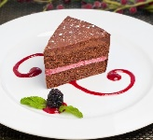
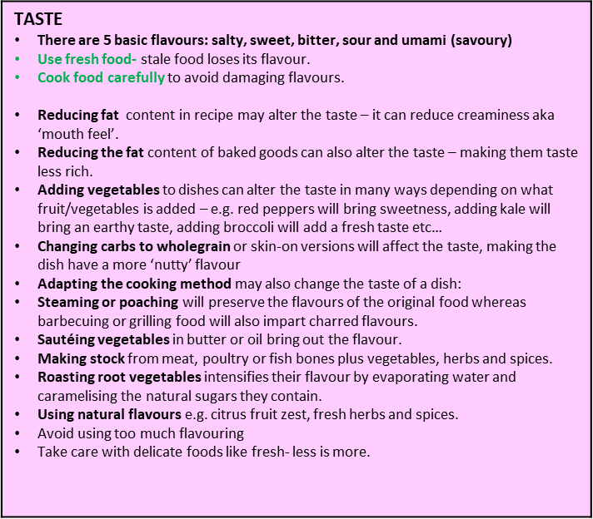
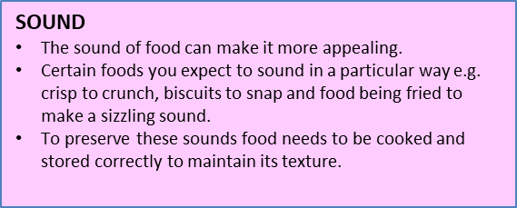
Year 11: Hospitality and Catering – Knowledge Organiser
AC 2.3 How menu meets customer needs- ORGANOLEPTIC
Organoleptic means the qualities of food that people experience with their senses. There are 5 senses: sight, smell, taste and sound. To enable people to enjoy their food, it is important that the menu planning, preparation, cooking serving food is carried out well so that food is appetising.
SIGHT: Appearance and presentation of the meal Adding vegetables to a dish to increase fibre, vitamins and minerals may also affect the colour of the dish. Adding greens such as green peppers or green beans will create a fresher, more vibrant look. Adding tomatoes/red peppers to a dish will make it look brighter. Remember – contrast in colours within a dish is good, makes dishes look more appealing and delicious! Changing carbs to wholegrain or skin-on versions may also change the colour of the dish, however this time may increase the presence of brown in the dish, which is considered a ‘dead’ or dull colour, and will need brightening up in other ways… Type of serving dishes. Garnishing Think cut, shape and form of food. Make sure plates and dishes are clean before serving food, to remove drips and splashes.
TOUCH: Texture
Use fresh food- stale food lose texture e.g. fruit, vegetables and fish.
Prepare food well to remove edible parts e.g. shell, bones, stalk, tough skin.
Cook food well to avoid unexpected textures e.g. lumps in a sauce, under cooked egg white, under cooked cake.
Cook food at correct temperature and for correct time to allow textures to develop e.g. when melting chocolate, baking cake or bread, frying chicken.
Reducing fat content in recipe may alter the texture, making it drier or more brittle.
Adding vegetables or fruits to dishes can bring crunchiness, softness, chewiness.
Changing the cooking method will also alter the texture – frying or roasting food in fat creates crispy crunchy textures, whereas replacing frying/roasting with the healthier methods of steaming, boiling, stewing etc will create soft textures. Grilling and barbecuing will also create chewy/crispy textures.

Slide 2
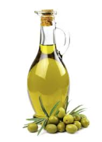
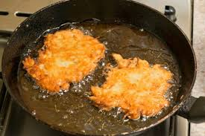
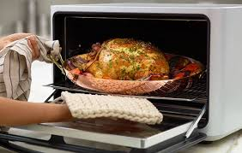
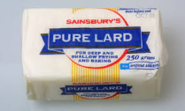
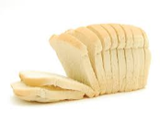
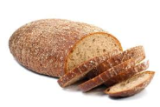
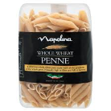
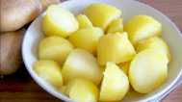
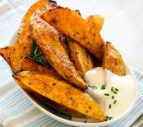
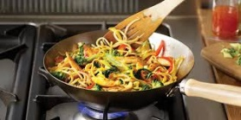
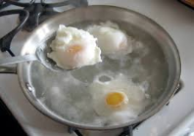
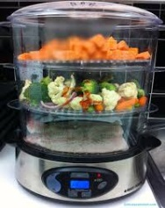
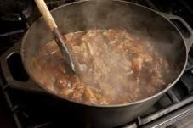
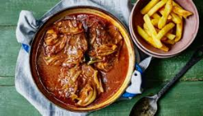
AC 2.3 How menu meets customer needs- Nutritional
Preparation methods
Do not add too much extra fat when preparing/marinating or cooking
Trim fat off excess fat from meat where possible (leaving some is fine for flavour)
Do not add too much extra salt when seasoning/marinating foods before cooking
Do not add too much sugar when marinating foods
Cooking methods
Some cooking methods add fat, adding too much fat to food increase the calories (energy content) drastically and is also thought to be a risk factor in cardiovascular disease. Cooks should be minimise their use where possible. These include:
Frying - deep (submerging food in hot fat)
Frying – shallow (frying food in 1cm or less of fat in a pan)
Roasting (cooking in fat in the oven)
Healthier cooking methods only add small amounts of fat, or do not add fat to food at all. They can be dry (cooking without the use of water) or moist (cooking with water or steam). Healthier cooking methods include:
Stir frying (cooking quickly in a small amount of oil at v high temps)
Poaching (cooked gently in simmering liquid)
Boiling (cooking food submerged in vigorously boiling ‘rolling boil’ water
Steaming (holding food above boiling water to be cooked by the steam)
Grilling – on a cooker or on a BBQ (food cooked by radiant heat from a flame or glowing element)
Baking in the oven (dry heat)
Stewing (slow-cooking on hob or in slow-cooker with liquid)
Casseroling (slow-cooking in oven with liquid)
Braising (slow-cooking pre-sealed meat and vegetables in oven with liquid)
CHANGE THE INGREDIENTS USED:
Avoid saturated fats such as butter, lard and dripping - Use heart healthy unsaturated fats such as olive oil, avocado oil
Avoid using white flour where possible – use wholegrain or brown versions for extra fibre and B vitamins
Leave the skin on potatoes for extra fibre and vitamin C
Replace cream in recipes with reduced fat crème fraiche
Replace mild cheeses with stronger ones, and use less
REDUCE sugar content of recipes by using naturally sweet ingredients such as fruits
Add extra VEGETABLES, FRUITS, NUTS and SEEDS into recipes where possible, for extra fibre, vitamins and minerals - these can be blended into sauces to ‘hide’ them for fussy eaters

