Slide 1
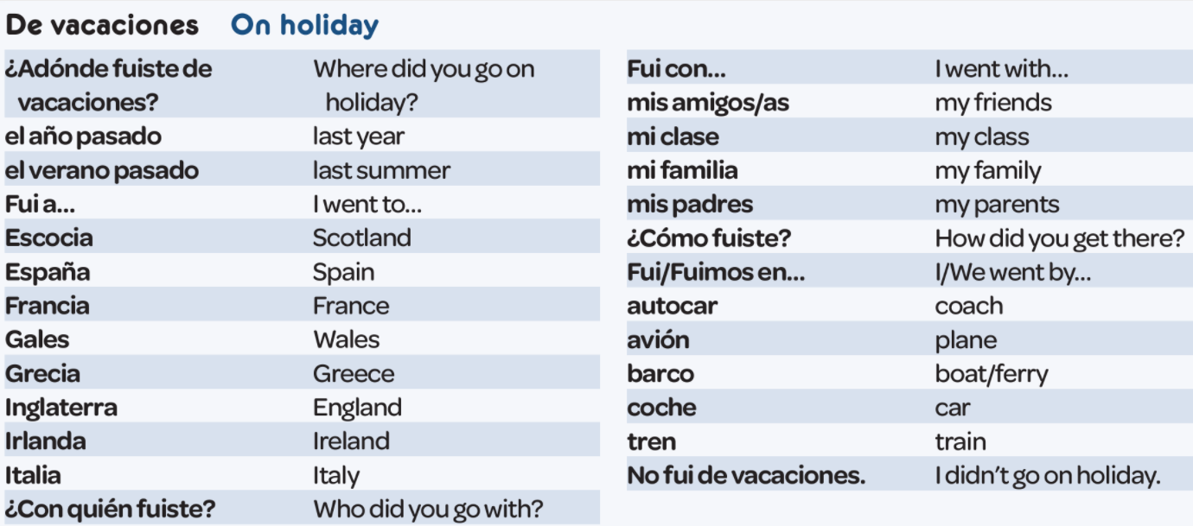
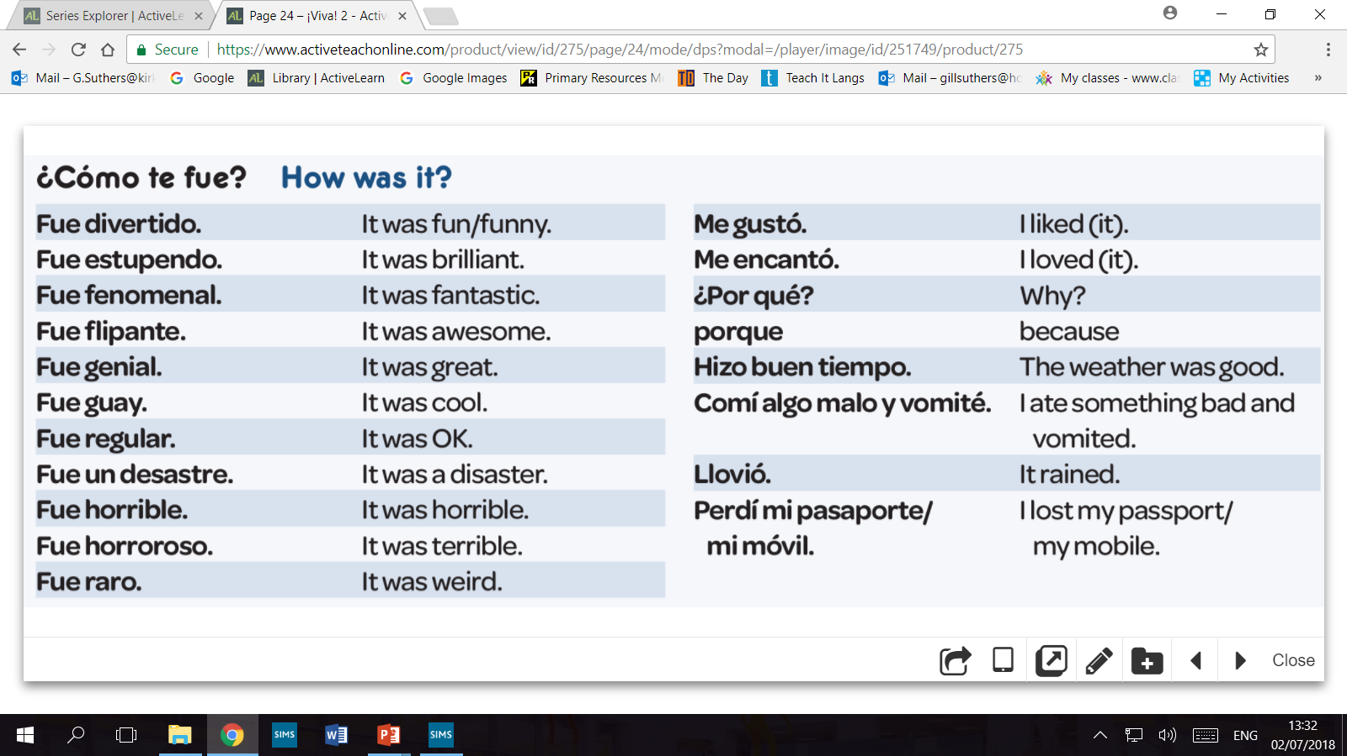
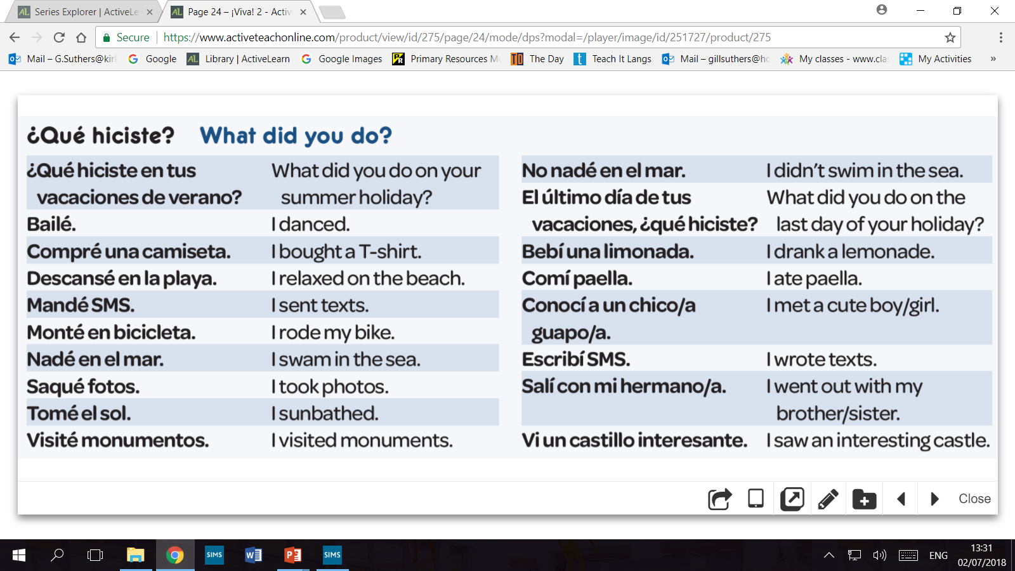
Year 8
Module 3
Mis vacaciones – KO3

Slide 2
Revise, revise, revise!
Sometimes, the only way to remember how to form and use different tenses is to learn them off-by-heart. Little and often is a good way to do this.

