Slide 1
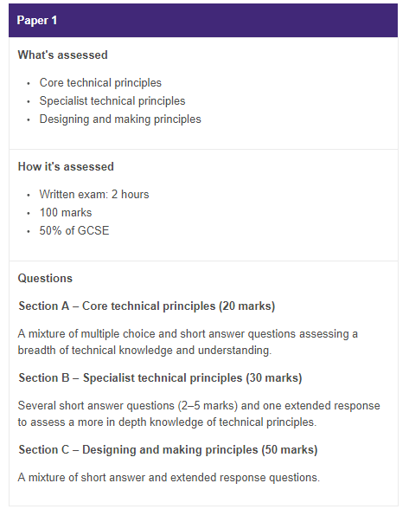
50% Written Exam Explained
What to expect in preparation for the GCSE exam.
A structured plan to ensure you get the best marks possible.
Teacher information
Student investigation
Focused practical work
Individual work
Group work
Practice exam questions
Homework tasks

Slide 2
Section A – 20 Marks
Multiple choice and short answers

Slide 3
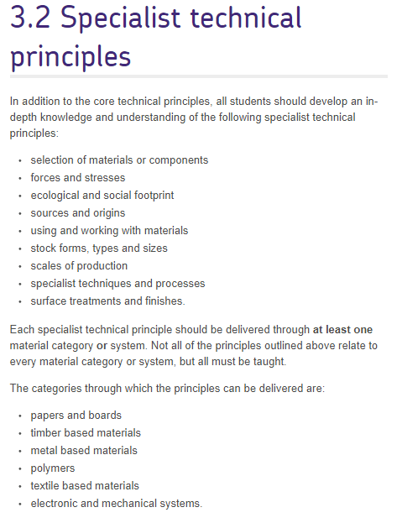
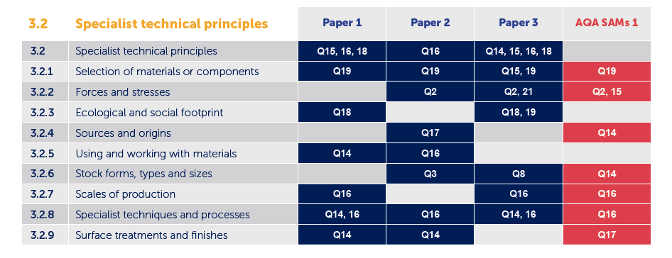
Section B – 30 Marks
Short answers (3-5marks) one extended response

Slide 4
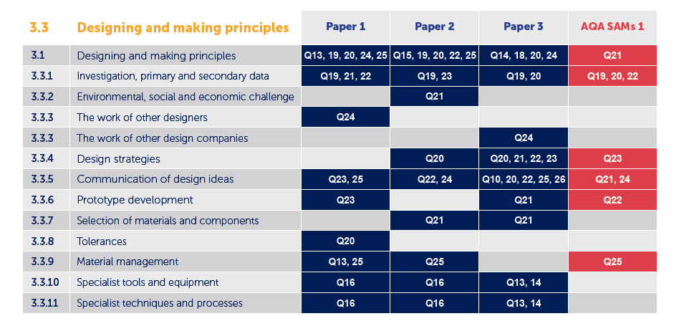
Section C – 50 Marks
A mixture of short and extended responses.

Slide 5
Week beginning | Lesson
7th Jan | 1
7th Jan | 1
7th Jan | 2
14th Jan | 3
14th Jan | 1
14th Jan | 2
14th Jan | 3

Slide 6
Week beginning | Lesson
21st Jan | 1
21st Jan | 2
21st Jan | 3
28th Jan | 1
28th Jan | 2
28th Jan | 3
4th Feb | 1
4th Feb | 2
4th Feb | 3
4th Feb | 3

Slide 7
Week beginning | Lesson
25th Feb | 1,2
25th Feb | 3
25th Feb | 3
4th March | 1
4th March | 1
4th March | 2
4th March | 3
11th March | 1
11th March | 2
11th March | 3
1st April | 1
1st April | 2
1st April | 3
Easter!!!!

